Slide 1
L8 Enzymes

Slide 2
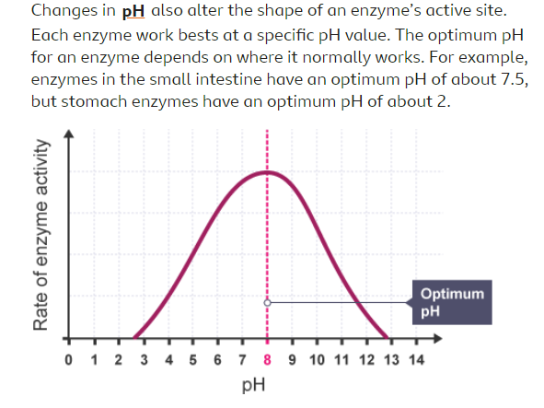
pH
Where do you think the enzyme in this graph is probably found?- stomach or intestine?
What do you think would happen to enzymes made in the stomach when they go into the small intestine?

Slide 3
The ‘lock and key theory’ is a simplified model of how enzymes work
https://www.youtube.com/watch?v=qgVFkRn8f10
Watch this clip which explains how enzymes work – including the word
ACTIVE SITE
Once you have watched this answer the questions on the next slide.

Slide 4
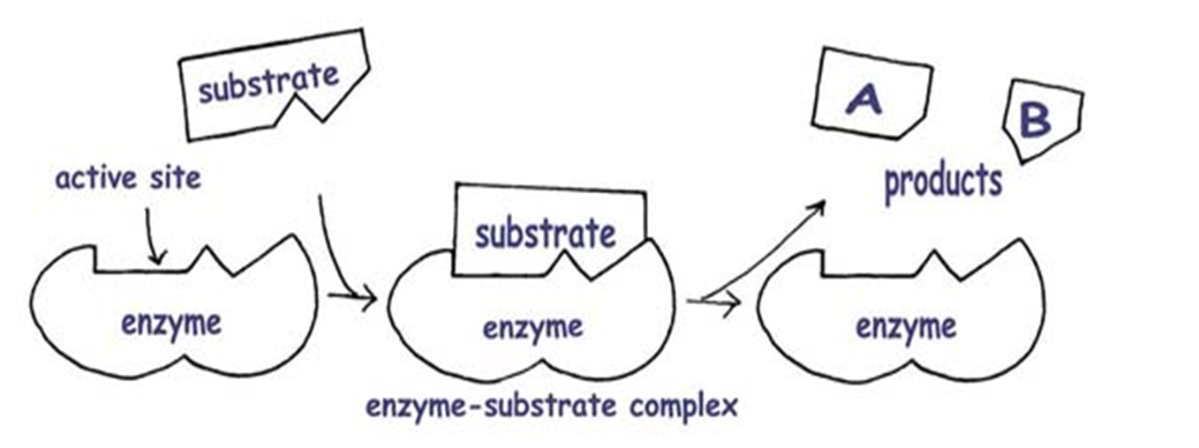
A QUICK REMINDER OF LOCK and KEY
FOR AN ENZYME TO WORK:it must come into contact with the substrate
its active site shape must complement that of the substrate (lock and key)
Understand the lock and key theory as a model to explain enzyme action
Enzymes catalyse specific reactions in living organisms due to the shape of their active site.

Slide 5
Now answer these questions
What type of molecule is an enzyme?
What are the molecules which bind with enzymes called?
Which part of an enzyme do molecules bind to?
What effect do enzymes have on reactions?
Why is an enzyme a catalyst?
What does ‘denatured’ mean?

Slide 6
https://www.bbc.co.uk/bitesize/guides/z89mk2p/revision/2
Read through the ‘revise’ section in this BBC bitesize on digestion
Then do the ‘test’

