Slide 1
Metals, Non-Metals and the Periodic Table
Learning objectives:
To link together electronic structures and the periodic table
To describe how metals and non-metals differ
To link together noble gas electronic structures to the other atoms in their period

Slide 2
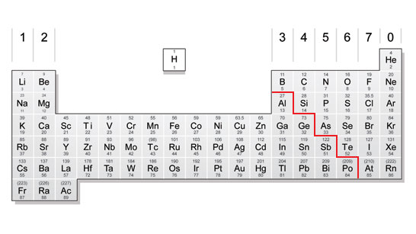
The periodic table has vertical columns that are called groups. The group number tells you how many electrons are in the outer shell of an atom of that element.
The horizontal periods tell you how many electron shells there are in the atom of that element.
The metals are on the left hand side of the periodic table. The non-metals are on the right hand side.
Group 1 elements lose 1 electron to form +1 ions
Group 2 elements lose 2 electrons to form +2 ions
Group 3 elements lose 3 electrons to form +3 ions
Group 4 doesn’t form ions
Group 5 elements gain 3 electrons to form -3 ions
Group 6 elements gain 2 electrons to form -2 ions
Group 7 elements gain 1 electron to form -1 ions
Group 0 doesn’t form ions

Slide 3
Sort the following statements into “metals”, “non-metals” and “both” on a Venn diagram
Metals
Non-Metals

Slide 4
Sort the following statements into “metals”, “non-metals” and “both” on a Venn diagram
Conducts heat well
Examples: Li, Mg, Cu
Lose electrons to form positive ions.
Conducts electricity
Doesn’t normally conduct heat
Involved in ionic bonding
Gain electrons to form negative ions
Normally a solid at room temperature (high melting point)
Normally a gas or liquid at room temperature
Doesn’t normally conduct electricity
Examples: C, N, O

Slide 5
Sort the following statements into “metals”, “non-metals” and “both” on a Venn diagram
Metals
Non-Metals
Lose electrons to form positive ions.
Examples: Li, Mg, Cu
Doesn’t normally conduct electricity
Gain electrons to form negative ions
Conducts heat well
Conducts electricity
Involved in ionic bonding
Doesn’t normally conduct heat
Examples: C, N, O
Normally a solid at room temperature (high melting point)
Normally a gas or liquid at room temperature

Slide 6
Watch the following video on noble gases
https://www.tes.co.uk/teaching-resource/Video-resource-on-Group-8-18-The-Noble-G-6339973/

Slide 7
Complete the Table!
Element | Symbol | State at room temp |  | Reaction?
 | He | Gas | -269
 | Ne |  | -246
Argon |  |  | -186 | None
 | Kr |  | -152
Xenon |  |  | -108
What happens to the boiling points as you go down the group? Why?
Can you think of a reason why they are so unreactive?

Slide 8
Complete the Table!
Element | Symbol | State at room temp | Boiling point (°C) | Reaction?
Helium | He | Gas | -269 | None
Neon | Ne | Gas | -246 | None
Argon | Ar | Gas | -186 | None
Krypton | Kr | Gas | -152 | None
Xenon | Xe | Gas | -108 | None
What happens to the boiling points as you go down the group? Why?
They increase because the atomic mass increases so the intermolecular forces of attraction increase
Can you think of a reason why they are so unreactive?
They have a full outer shell

Slide 9
Draw the atomic structures of Ne and He
Draw the ionic structures of the following elements (look at the group to see how many electrons the element will lose/gain).
Li, Be, B, N, O, F
What do you notice about the ionic structures of these elements compared to the atomic structures of He and Ne?

Slide 10
He
Draw the atomic structures of Ne and He
Draw the ionic structures of the following elements (look at the group to see how many electrons the element will lose/gain).
Li, Be, B, N, O, F
What do you notice about the ionic structures of these elements compared to the atomic structures of He and Ne?
Li⁺, Be²⁺ and B³⁺ look like He, N³⁻, O²⁻ and F⁻ look like Ne
The ionic structures of metals look like the atomic structure of the nobel gas of the previous period. The ionic structures of non-metals look like the atomic structure of the nobel gas of the same period.
Ne
3-
2-
-
+
2+
3+
N
O
F
Li
Be
B

