Slide 1
Group 1 Alkali Metals
Learning objectives
To describe the reactions of different alkali metals
To draw the electron diagrams for the alkali metals
To explain the reactivity trend of alkali metals using shielding

Slide 2
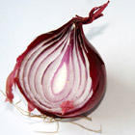
What do you already know?
Which group on the periodic table are the Alkali metals in?
What is the electronic structure of Oxygen (O)?
What is the electronic structure of Sodium (Na)?
What sort of bonding do the group 1 metals do?
How can you relate the structure of an atom to an onion?

Slide 3
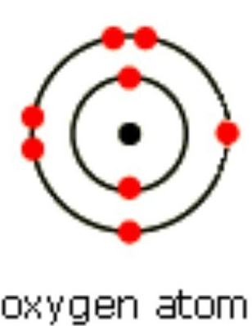
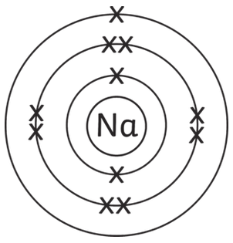
What do you already know?
Which group on the periodic table are the Alkali metals in? Group 1
What is the electronic structure of Oxygen (O)?
What is the electronic structure of Sodium (Na)?
What sort of bonding do the group 1 metals do? Ionic
How can you relate the structure of an atom to an onion? Atoms have layers of electrons (shells)

Slide 4
Reactions of Lithium, Sodium and Potassium
Watch this video
https://www.youtube.com/watch?v=sGQrewgfCF4
Why does the water turn purple when universal indicator is added?
Hydrogen gas is produced in this reaction, how could we test for hydrogen?

Slide 5
Reactions of Lithium, Sodium and Potassium
Watch this video
https://www.youtube.com/watch?v=sGQrewgfCF4
Why does the water turn purple when universal indicator is added? Because an alkali is produced
Hydrogen gas is produced in this reaction, how could we test for hydrogen? Lit splint → squeaky pop

Slide 6

Reaction of Rubidium

Slide 7
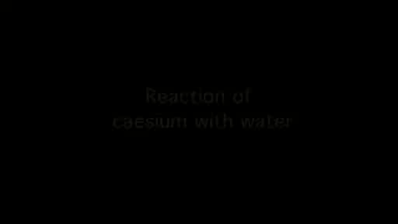
Reaction of Caesium

Slide 8
Why?
Draw the electron structure for these elements in group 1:
Li (3 electrons), Na (11 electrons), K (19 electrons),
What do you notice?
What is the equation for the reaction between the group 1 metals and water?
What is the trend in reactivity for group 1?
What is happening in this reaction in terms of electrons?
How can this relate to the trend in reactivity? (Hint: think back to the beginning of the lesson)

Slide 9
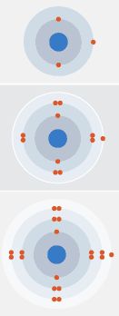
Why?
Li
Draw the electron structure for these elements in group 1:
Li (3 electrons), Na (11 electrons), K (19 electrons),
What do you notice?
What is the equation for the reaction between the group 1 metals and water? E.g. Li 2Li + 2H₂O → 2LiOH + H₂
What is the trend in reactivity for group 1? The group 1 metals become more reactive down the group
What is happening in this reaction in terms of electrons? The group 1 metals are loosing electrons
How can this relate to the trend in reactivity? (Hint: think back to the beginning of the lesson)
  Down the group the number of shells increases
  So the outer shell electrons become farther away from the nucleus, there is more shielding and the outershell electrons feel less attraction
  Less energy is needed to remove them, therefore the reactivity increases
Na
K

Slide 10
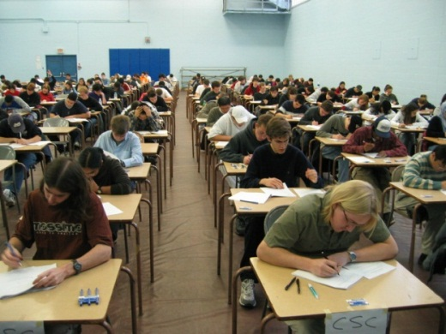
Exam Question!
Explain the trend in reactivity as you go down group 1. Refer to what you know about the electron structure of the elements. [6]

Slide 11
Mark Scheme
As you go down the group the reactivity increases.
The alkali metals all have one outer electron
They all form 1+ ions
As you go down the group, the atoms become bigger
The outer electron is further away from the nucleus (it is shielded by the other electrons)
The outer electron is held less tightly, and is more easily lost

