Slide 1
Group 7
Content: To describe the nature of the compounds formed when chlorine, bromine and iodine react with metals and non-metals.
To describe trends in physical and chemical properties in group 7
To interpret displacement reactions in terms of reactivity.
Process: individual work
Practical work
Benefits: recognising trends
Following instructions carefully

Slide 2

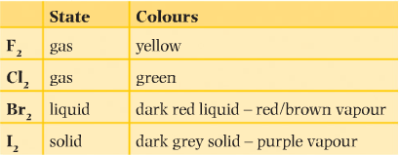
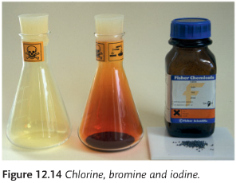
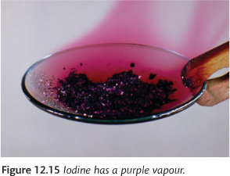
Physical Properties
Diatomic molecules
The boiling point increases down the group because the molecular mass increases (therefore there are stronger intermolecular forces of attraction)
Boiling point increases
Boiling point?
Copy the table into your book
Predict the state and colour of astatine (At₂), give your reasons

Slide 3
Physical Properties
Diatomic molecules
The boiling point increases down the group because the molecular mass increases (therefore there are stronger intermolecular forces of attraction)
Boiling point increases
Boiling point?
Copy the table into your book
Predict the state and colour of astatine (At₂), give your reasons
State: solid (boiling point increases down the group)
Colour: black (colour gets darker down the group)

Slide 4
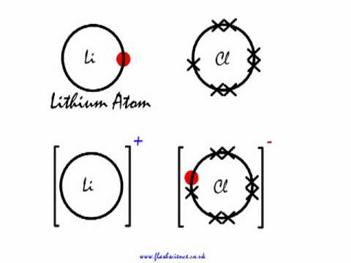
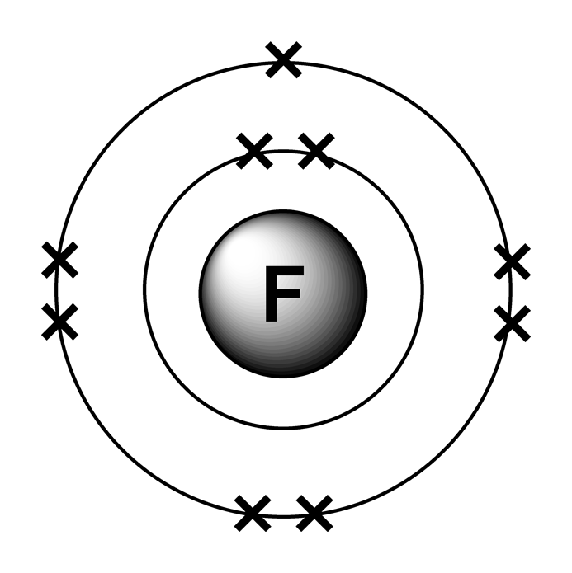
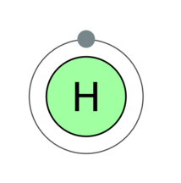
Group 7 Compounds
How do group 7 elements bond with metals (e.g. group 1)?
How do group 7 elements bond with non-metals (e.g. hydrogen)?

Slide 5
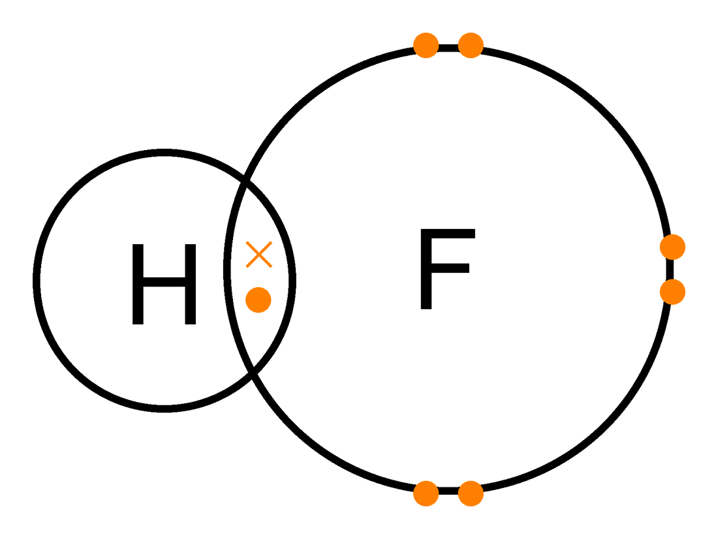
Group 7 Compounds
Group 7 elements bond with metals ionically (transfer electrons)
Group 7 elements bond with non-metals covalently (share electrons)

Slide 6
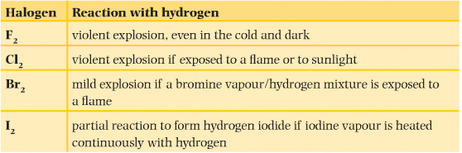
Reactions with hydrogen
Look at the table above. Write a description of the trend in reactivity for the halides.

Slide 7
Reactions with hydrogen
Look at the table above. Write a description of the trend in reactivity for the halides.
The halogens become less reactive down the group

Slide 8
Watch the following video
https://www.youtube.com/watch?v=HW2jRyQ3dzo
Complete the following table for the colour changes you saw in the video (leave enough space to add the reaction that’s taking place!)
 | Potassium chloride | Potassium bromide | Potassium Iodide
Chlorine water
Bromine water
Potassium water
Chlorine, bromine and iodine dissolved in water

Slide 9
Watch the following video
https://www.youtube.com/watch?v=HW2jRyQ3dzo
Complete the following table for the colour changes you saw in the video (leave enough space to add the reaction that’s taking place!)
 | Potassium chloride | Potassium bromide | Potassium Iodide
Chlorine water | No change | Colourless to orange | Colourless to brown
Bromine water | No change | No change | Colourless to brown
Potassium water | No change | No change | No change
Chlorine, bromine and iodine dissolved in water

Slide 10
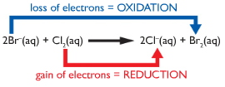
Displacement Reactions
Potassium bromide + chlorine water (colourless → orange)
Chlorine displaces the less reactive bromide:
2KBr(aq) + Cl₂(aq) → 2KCl(aq) + Br₂(aq)
Colourless
Orange bromine produced
Reactivity decreases

Slide 11
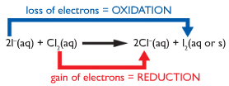
Displacement Reactions
Potassium iodide + chlorine water (colourless → brown)
Chlorine displaces the less reactive iodide:
2KI(aq) + Cl₂(aq) → 2KCl(aq) + I₂(aq)
Colourless
Brown iodine produced
Reactivity decreases

Slide 12
Displacement Reactions
Potassium iodide + bromine water (colourless → orange)
Bromine displaces the less reactive iodide:
2KI(aq) + Br₂(aq) → 2KCl(aq) + Br₂(aq)
Colourless
Orange bromine produced
Reactivity decreases

Slide 13
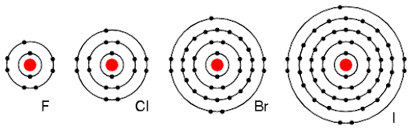
What do you notice about the electron structures of the group 7 elements (halogens)?
What is the trend in reactivity for group 1?
What is happening in this reaction in terms of electrons?
How can this relate to the trend in reactivity? (Hint: think back to group 1 metals)
CHALLENGE: Compare the trend in reactivity of group 7 to group 1? Why do group 1 metals get more reactive down the group but group 7 elements get less reactive down the group?

Slide 14
What do you notice about the electron structures of the group 7 elements (halogens)?
What is the trend in reactivity for group 1? Group 7 elements become less reactive down the group
What is happening in this reaction in terms of electrons? The group 7 elements are gaining electrons
How can this relate to the trend in reactivity? (Hint: think back to group 1 metals)
  Down the group the number of shells increases
  So the outer shell becomes farther away from the nucleus, there is more shielding and there is less attractive force on an incoming electron
  Therefore the reactivity decreases
CHALLENGE: Compare the trend in reactivity of group 7 to group 1? Why do group 1 metals get more reactive down the group but group 7 elements get less reactive down the group?
  Even though for both groups the number of shells increases, so the amount of shielding increases and the outer shell of electrons is farther away from the nucleus and therefore feels less attraction
  Group 1 metals lose electrons when they react, which becomes easier to do when the attraction is lower
  Group 7 elements gain electrons when they react, which becomes harder to do when the attraction is lower

Slide 15
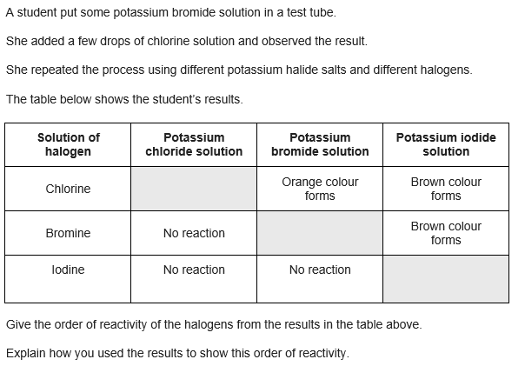


Slide 16



