Slide 1
Atomic Structure Revision
To determine the structure of ions and isotopes
To recall the history of the atom
To calculate the relative atomic mass using data on isotope abundance

Slide 2
Retrieval Grid – get as many points as you can!
1 point | 5 points | 10 points
What are the names of the 3 sub-atomic particles? | What are the relative charges and masses of the 3 sub-atomic particles? | Why does a metal form a positive ion?
What does the atomic number tell you? | Why does an atom have an equal number of protons and electrons? | What is an ion? How is it formed?
What does the mass number tell you? | What is an isotope? | Why does chlorine have a mass number of 35.5?

Slide 3
1 point | 5 points | 10 points
What are the names of the 3 sub-atomic particles? Protons, neutrons and electrons | What are the relative charges and masses of the 3 sub-atomic particles? | A metal has <4 electrons in the outer shell, so it’s easier to lose electrons. Losing electrons means more protons than electrons, therefore +
What does the atomic number tell you? Number of protons | Why does an atom have an equal number of protons and electrons? So the charge is neutral | What is an ion? How is it formed? A charged atom, formed by losing or gaining electrons.
What does the mass number tell you? Number of protons and neutrons | What is an isotope? An atom with the same number of protons, but a different number of neutrons. | Why does chlorine have a mass number of 35.5? It is an average mass, taking abundance of the different isotopes into account.
Particle | Relative charge | Relative mass
Proton | +1 | 1
Neutron | 0 | 1
Electron | -1 | Very small

Slide 4
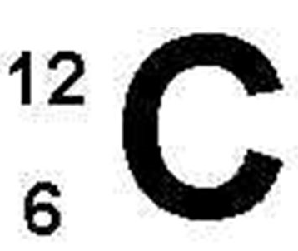
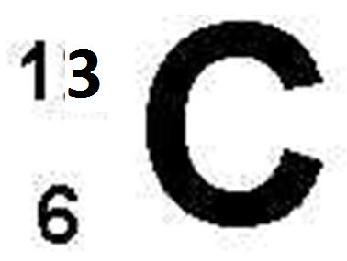
How many protons, neutrons and electrons are in each isotope of carbon?
What determines the element symbol for each isotope (i.e. why are they both carbon)?
What is an isotope?
What is the symbol for this isotope: ?
Challenge: Draw a diagram to show the atomic structure of these isotopes of hydrogen: H H and H
Super challenge: How do you think the physical and chemical properties of these isotopes are different/the same?
38
1
2
3
1
1
1
17

Slide 5
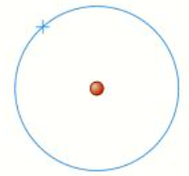
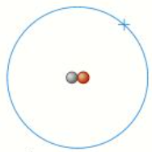
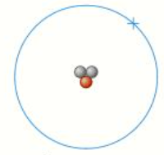



6 protons
6 neutrons
6 electrons
6 protons
7 neutrons
6 electrons
What determines the element symbol for each isotope (i.e. why are they both carbon)? The number of protons
What is an isotope? An atom with the same number of protons, but a different number of neutrons
What is the symbol for this isotope: Cl
38
Super challenge: How do you think the physical and chemical properties of these isotopes are different/the same? The number of electrons are the same, so the chemical properties will be the same. The physical properties, such as melting and boiling point would be different.
17

Slide 6
Relative Atomic Mass, A_{r}
Relative masses are much more convenient to use than actual masses of atoms.
Carbon-12 is used as the reference point. It is given a ‘mass’ of 12 units.
All of the other A_{r} values are the mass of the element compared to carbon.
A_{r} is the average relative atomic mass, taking isotopes into account.
e.g. copper has 2 isotopes, ⁶³Cu (69%) and ⁶⁵Cu (31%)
A_{r} of Cu = (69x63) + (31x65) = 63.5
100
Calculate the relative atomic mass, A_{r} , for chlorine, where 25% of atoms are ³⁷Cl and 75% are ³⁵Cl. Show your working. Give your answer to 1d.p.
Calculate the relative atomic mass, A_{r}, for magnesium, where 79% of atoms are magnesium-24, 10% are magnesium-25 and the rest have 14 neutrons. Show your working. Give your answer to 1d.p.
Nitrogen is made up of two isotopes, N-14 (99.3%) and N-15. Given nitrogen's atomic weight of 14.007, what is the percent abundance of N-15? (HINT: You will need to use algebra for your unknown percentage)

Slide 7
Relative Atomic Mass, A_{r}
1. Calculate the relative atomic mass, A_{r} , for chlorine, where 25% of atoms are ³⁷Cl and 75% are ³⁵Cl. Show your working.
A_{r} of Cl = (25x37) + (75x35) = 35.5
100
2. Calculate the relative atomic mass, A_{r}, for magnesium, where 79% of atoms are magnesium-24, 10% are magnesium-25 and the rest have 14 neutrons. Show your working.
A_{r} of Mg = (79x24) + (10x25) + (11x26) = 24.3
100
3. Nitrogen is made up of two isotopes, N-14 (99.3%) and N-15. Given nitrogen's atomic weight of 14.007, what is the percent abundance of N-15?
14.007 = (99.3x14) + (a x 15) a= 0.7%
100

Slide 8
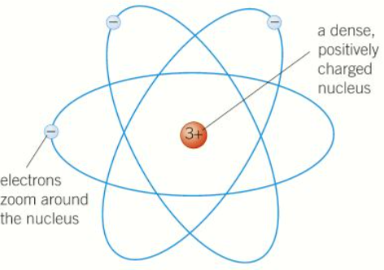
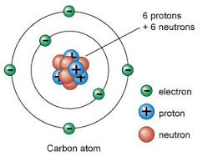
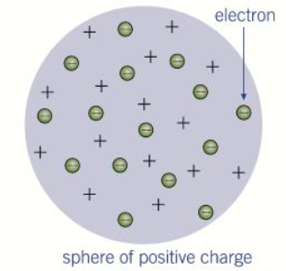

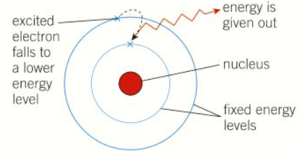
History of the Atom
Put the diagrams into chronological order to show the theories of the structure of the atom.
What was the evidence for each theory?

Slide 9
History of the Atom
Put the diagrams into chronological order to show the theories of the structure of the atom.
What was the evidence for each theory?
Applied high voltages to gases. The beams of particles were attracted to a positive charge (so they must be negative).​
Atoms are uncharged overall.
Centuries of experiments into atoms and elements.
Alpha particles fired at gold foil, they did not go straight through the gold foil, as expected from the plum pudding model.
Light given out when atoms are heated are only certain amounts of energy.
Tracking particle radiation led to the discovery of a particle which had the same mass as a proton, but was uncharged.​

Slide 10
(a) What does the number 19 represent in ? (1)
(b) The plum pudding model of the atom was replaced by the nuclear model.
The nuclear model was developed after the alpha particle scattering experiment.
Compare the plum pudding model with the nuclear model of the atom. (4)
(c) An element has three isotopes.
The table shows the mass numbers and percentage of each isotope.
Calculate the relative atomic mass (A_{r}) of the element.
Give your answer to 3 significant figures. (2)
 | Isotope 1 | Isotope 2 | Isotope 3
Mass number | 24 | 25 | 26
Percentage (%) | 78.6 | 10.1 | 11.3
Challenge: Identify how many protons, neutrons and electrons are in the following ions:
Mg²⁺
O²⁻
Aluminium ion

Slide 11

(a) mass number
allow the number of protons + neutrons
(b)
Similarities
• both have positive charges
• both have (negative) electrons
• neither has neutrons
Differences
(c)
or
(24 × 0.786) + (25 × 0.101) + (26 × 0.113) = 24.3
plum pudding model | nuclear model
ball of positive charge (spread throughout) | positive charge concentrated at the centre
electrons spread throughout (embedded in the ball of positive charge) | electrons outside the nucleus
no empty space in the atom | most of the atom is empty space
mass spread throughout | mass concentrated at the centre
Challenge: Identify how many protons, neutrons and electrons are in the following ions:
Mg²⁺ :12 protons, 12 neutrons, 10 electrons
O²⁻ :8 protons, 8 neutrons, 10 electrons
Aluminium ion : (Al³⁺) 13 protons, 14 neutrons, 10 electrons

Slide 12
How many protons, neutrons and electrons are in these ions?
Li⁺
O²⁻
F⁻
An aluminium ion
A magnesium ion
A sulphide ion
Draw diagrams to show the electronic configuration and charges on these ions:
Cl⁻
Be²⁺
A calcium ion
A sodium ion
A potassium ion
Draw diagrams and use these to work out the formulae for these ionic compounds:
Magnesium oxide
Sodium fluoride
Potassium sulphide
Calcium chloride

Slide 13
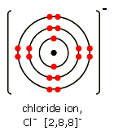
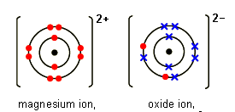
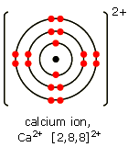
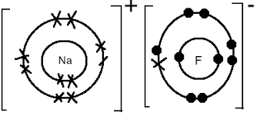
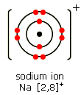
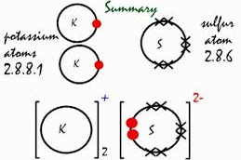
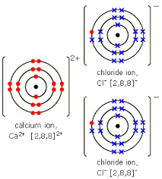
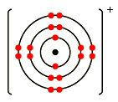
How many protons, neutrons and electrons are in these ions?
Li⁺ p=3, n=4, e=2
O²⁻ p=8, n=8, e=10
F⁻ p=9, n=10, e=10
An aluminium ion p=13, n=14, e=10
A magnesium ion p=12, n=12, e=10
A sulphide ion p=16, n=16, e=18
2+
Be
Potassium ion

