Slide 1
Dot Cross Revision
To draw electronic structures for atoms and ions
To draw dot-cross diagrams showing ionic bonding
To use dot-cross diagrams to identify ionic formulae

Slide 2
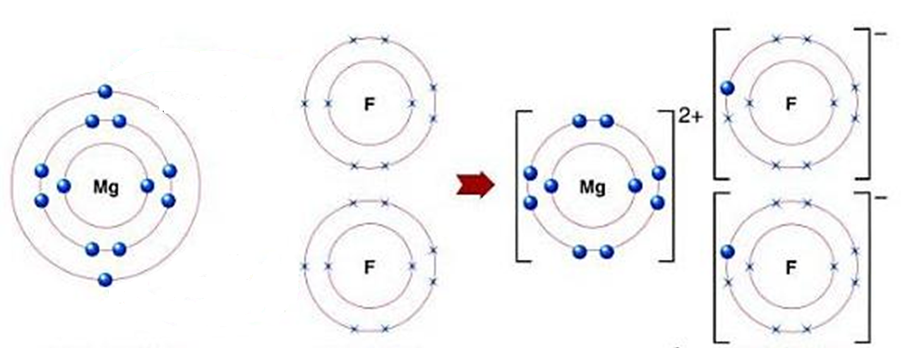
Describe what the diagram is showing in as much detail as you can.
Challenge: What happens when lithium bonds with oxygen? How is this different from the example above?

Slide 3
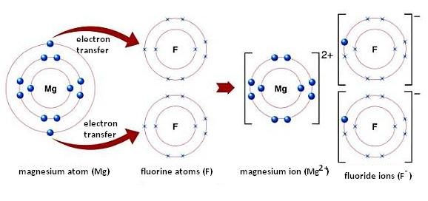
Challenge: Oxygen takes lithium’s outer shell electron. Oxygen needs 2 electrons, so it takes 1 electron from 2 lithium atoms (2 lithium atoms bond with one oxygen atom).

Slide 4


Pit stop one
All to do first draw a table showing the relative masses and charges of the sub-atomic particles
Pit stop two
  Draw the electron structures of the following atoms:
  Carbon
  Lithium
  Oxygen
  Neon
  Magnesium
  Calcium
  Which are metals and which are non-metals? How do you know?
Pit stop four
“Explain why metal atoms form positively charged ions but non-metals form negatively charged ions.” 6 marks Use the previous tasks as hints to help explain your answer.
Pit stop three
Draw a dot-cross diagram to show the bonding in each of these compounds:
NaF
MgO
CaCl₂
Li₂O

Slide 5
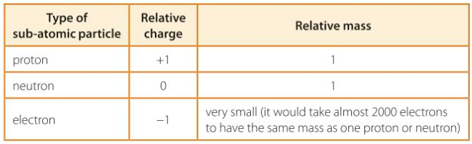
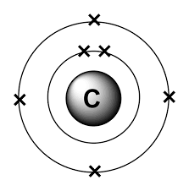
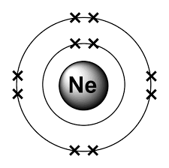
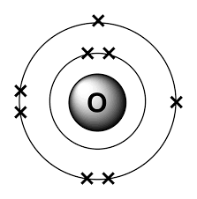
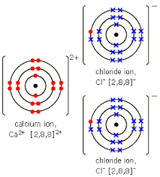
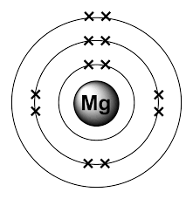
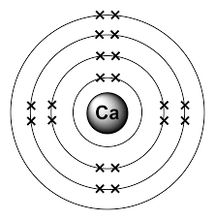
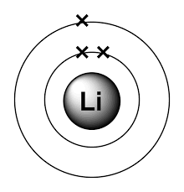
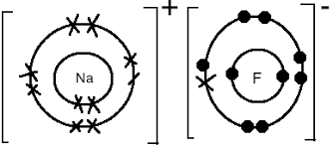
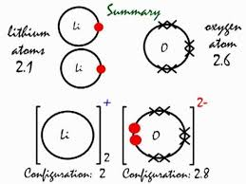
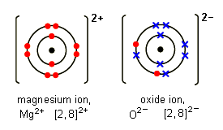
Pit stop two
The elements above are non-metals as they are found on the right of the staircase, the elements below are metals because they are found on the left of the staircase
Pit stop one:
Non-metals
Pit stop four
“Explain why metal atoms form positively charged ions but non-metals form negatively charged ions.” 6 marks
metal atoms have fewer electrons in outer shell
so lose electrons to form ions
with stable electronic structure of noble gas
ions contain more protons than electrons, giving positive ions.
Non-metal atoms with 5, 6 or 7 electrons in outer shells
gain electrons to form ions
with electronic structure of noble gas
ions have more electrons than protons, resulting in negative ions
Metals
Pit stop three

Slide 6
More Diagrams: Choose your task
Illustrate the electrons, protons and neutrons in the following particles. Make sure your diagram shows how many of each sub-atomic particle there are:
Nitrogen atom
Potassium atom
Fluorine atom
Beryllium atom
Cl⁻ ion
Aluminium ion
Draw dot-cross diagrams to show these ionic compounds:
CaS
KCl
Na₂O
Magnesium chloride
Use what you know about ions to write the formulae of these ionic compounds:
Calcium fluoride
Potassium sulfide
Magnesium bromide
Strontium iodide
Aluminium chloride
Aluminium oxide
A sulfate ion has the formula: SO₄²⁻
What are the formulae of:
Calcium sulfate?
Potassium sulfate?
Aluminium sulfate?
How is sulfate different from sulfide?

Slide 7
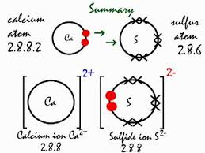
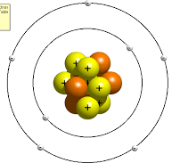
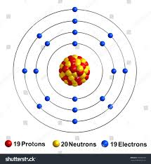
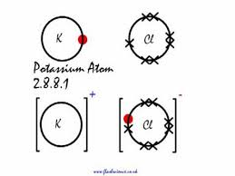
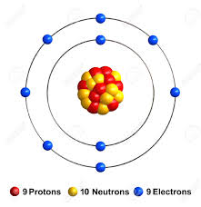
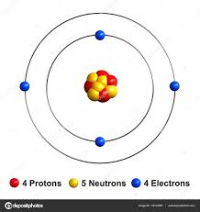
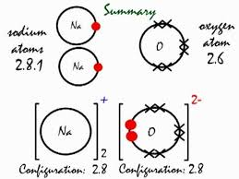
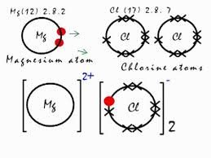
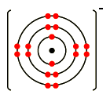
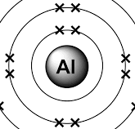
Nitrogen Potassium
Fluorine
Berylium
³⁵Cl⁻ ion Aluminium ion
Use what you know about ions to write the formulae of these ionic compounds:
Calcium fluoride: CaF₂
Potassium sulfide: K₂S
Magnesium bromide: MgBr
Strontium iodide: SrI₂
Aluminium chloride: AlCl₃
Aluminium oxide: Al₂O₃
A sulfate ion has the formula: SO₄²⁻
What are the formulae of:
Calcium sulfate CaSO₄
Potassium sulfate K₂SO₄
Aluminium sulfate Al₂(SO₄)₃
Sulfate contains oxygen, sulfide doesn’t
p = 7, n = 7, e = 7
3+
p =13
n = 14
e = 10
p = 17, n = 18, e = 18

