Slide 1
Periodic Table Revision
To identify the patterns in the Periodic Table
To recall the reactions of group 1 and group 7 elements
To describe and explain the trends in group 1 and group 7

Slide 2
What do the group numbers on the Periodic Table tell you?
Where is the split on the Periodic Table that separates metals and non-metals?
Where are the Transition metals on the Periodic Table?
Draw the electronic structure of the first 3 elements in the alkali metals.
Draw the electronic structure of the first 2 elements in the halogens.
Describe the alkali metals in terms of appearance, density and reactivity.
Write a balanced symbol equation with state symbols to show sodium reacting with oxygen, lithium reacting with water and potassium reacting with chlorine.
What does diatomic mean? What group on the periodic table exists as diatomic molecules?
Describe the halogens in terms of boiling point, electrical and heat conductivity and appearance.
Write a balanced symbol equation with state symbols to show the reactions, if any, of bromine, chlorine and iodine with potassium bromide, potassium chloride and potassium iodide.
Describe the trend in reactivity in group 1 and group 7.
Explain the trend in reactivity for group 1, referring to electronic structure and shielding in your answer.
Explain the trend in reactivity for group 7, referring to electronic structure and shielding in your answer.

Slide 3
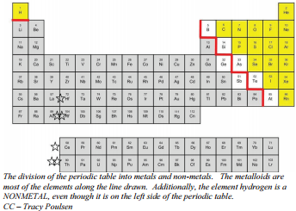
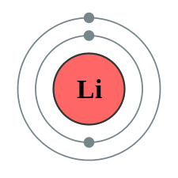
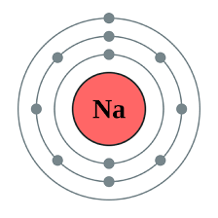
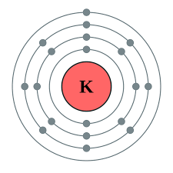
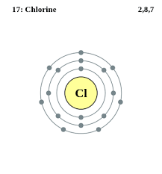
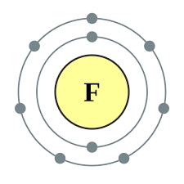
What do the group numbers on the Periodic Table tell you?
Where is the split on the Periodic Table that separates metals and non-metals?
Where are the Transition metals on the Periodic Table?
Draw the electronic structure of the first 3 elements in the alkali metals.
Draw the electronic structure of the first 2 elements in the halogens.
Describe the alkali metals in terms of appearance, density and reactivity.
The group number corresponds to the number of electrons on the outer shell.
Everything to the right of the red line = non-metals, everything to the left = metals
Everything inside box = transition metals
Group 1 metals are dull (shiny once cut), they have a low density and are very reactive.

Slide 4
Write a balanced symbol equation with state symbols to show sodium reacting with oxygen, lithium reacting with water and potassium reacting with chlorine.
What does diatomic mean? What group on the periodic table exists as diatomic molecules?
Describe the halogens in terms of boiling point, electrical and heat conductivity and appearance.
4Na(s) + O₂(g) → 2Na₂O(s)
2Li(s) + 2H₂O(l) → 2LiOH(aq) + H₂(g)
2K(s) + Cl₂(g) → 2KCl(s)
Diatomic means 2 atoms – group 7 elements exist as diatomic molecules e.g. Cl₂
Halogens have a low boiling point (increases as you go down the group), poor electrical and heat conductivity and have coloured vapours (fluorine = yellow, chlorine = green, bromine = reddish brown, iodine = purple).

Slide 5
Write a balanced symbol equation with state symbols to show the reactions, if any, of bromine, chlorine and iodine with potassium bromide, potassium chloride and potassium iodide.
Describe the trend in reactivity in group 1 and group 7.
Explain the trend in reactivity for group 1, referring to electronic structure and shielding in your answer.
Explain the trend in reactivity for group 7, referring to electronic structure and shielding in your answer.
Cl₂(aq) + 2KBr(aq) → 2KCl(aq) + Br₂(aq)
Cl₂(aq) + 2KI(aq) → 2KCl(aq) + I₂(aq)
Br₂(aq) + 2KI(aq) → 2KBr(aq) + I₂(aq)
Group 1 reactivity increases down the group, group 7 reactivity decreases down the group
Down the group the number of shells increases
So the outer shell electrons become farther away from the nucleus, there is more shielding and the outer shell electrons feel less attraction
Less energy is needed to remove them, therefore the reactivity increases
Down the group the number of shells increases
So the outer shell becomes farther away from the nucleus, there is more shielding and there is less attractive force on an incoming electron
Therefore the reactivity decreases

