Slide 1
Separation Revision
To name and describe the processes of separation
To recall information that could be in the test
To identify key words and use these to build sentences

Slide 2
Retrieval Practice
Answer the following questions
What is the difference between distillation and fractional distillation? | Fractional distillation is used for 2 or more liquids with close boiling points. Distillation is used for a dissolved solute and solvent.
What is crystallisation used for? | Separating a soluble solute from the solvent (e.g. salt and water) when you just want the solute.
How could you completely separate a mixture of water, sand and salt (and not lose anything)? | Filter the sand out. Wash the filtrate to make sure no salt is stuck to the sand. Use distillation to collect the water. The salt should be left in the flask.
Describe the process of chromatography. | Spot the unknown substance/mixture on a pencil line, along with some known substances (for reference). Allow the solvent to travel up the paper. Compare your unknown with the known compounds to identify.

Slide 3
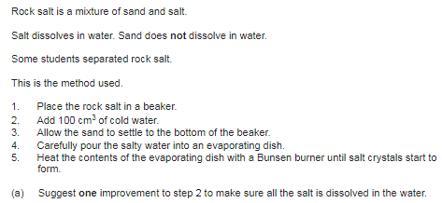
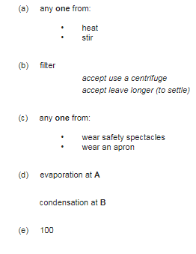

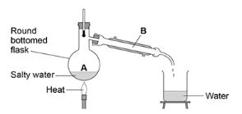
The solution would have to be heated to ethanol’s boiling point (78°C) but not above water’s boiling point (100°C) which is difficult to control with a Bunsen burner (better to use a temperature controlled water bath). Even then, a small amount of water will also evapourate so it won’t be pure ethanol.
Challenge: Why can the apparatus in the diagram not be used to separate water and ethanol?

Slide 4


Challenge: How can you calculate the R_{f} value using a chromatogram?

Slide 5
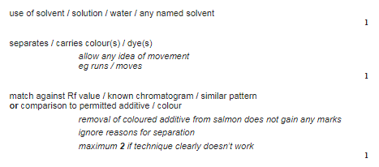
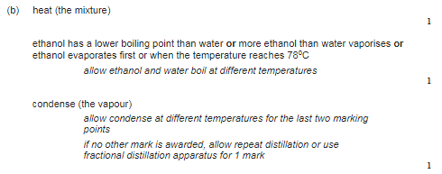
Challenge: How can you calculate the R_{f} value using a chromatogram?
R_{f} = Distance travelled by chemical spot / distance travelled by solvent

