Slide 1
Transition Metals
Content: To compare the transition metals to group 1 metals
To state some properties of transition metals
To give examples of how transition metals exhibit these properties

Slide 2
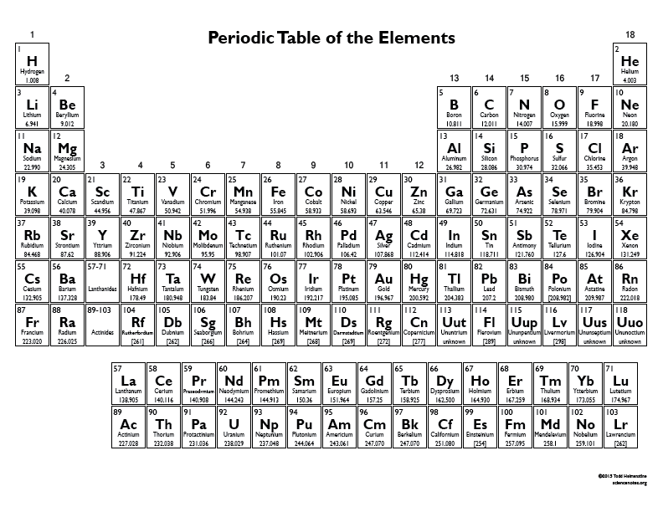
Where are the transition metals on the periodic table?
How do you think the transition metals compare to Group 1 metals in the following properties:
Density
Melting point
Strength
Hardness
Reactivity?
Challenge: What do you think the difference is between copper(I) oxide and copper(II) oxide?

Slide 3
How do you think the transition metals compare to Group 1 metals in the following properties:
Density TM>G1
Melting point TM>G1
Strength TM>G1
Hardness TM>G1
Reactivity TM<G1
Copper(I) oxide copper has a 1+ charge (Cu₂O) and copper(II) oxide copper has a 2+ charge (CuO)

Slide 4
Working Out Ionic Formulae
For an ionic compound, the overall charge of the compound should equal zero.
e.g. calcium chloride is made from Ca²⁺ ions and Cl⁻ ions.
To equal zero, you need 1 x Ca²⁺ and 2 x Cl⁻. The formula for calcium chloride is, therefore, CaCl₂.
What is the formula of magnesium oxide (Mg²⁺ O²⁻)?
What is the formula of sodium oxide (Na⁺ O²⁻)?
What is the formula of aluminium chloride (Al³⁺ Cl⁻)?
What is the formula of lithium chloride?
What is the charge on the copper ion in Cu₂O?
What is the charge on the iron ion in FeO?
What is the charge on the iron ion in Fe₂O₃?

Slide 5
Working Out Ionic Formulae
For an ionic compound, the overall charge of the compound should equal zero.
e.g. calcium chloride is made from Ca²⁺ ions and Cl⁻ ions.
To equal zero, you need 1 x Ca²⁺ and 2 x Cl⁻. The formula for calcium chloride is, therefore, CaCl₂.
What is the formula of magnesium oxide (Mg²⁺ O²⁻)?
What is the formula of sodium oxide (Na⁺ O²⁻)?
What is the formula of aluminium chloride (Al³⁺ Cl⁻)?
What is the formula of lithium chloride?
What is the charge on the copper ion in Cu₂O?
What is the charge on the iron ion in FeO?
What is the charge on the iron ion in Fe₂O₃?
MgO
Na₂O
AlCl₃
LiCl
Cu⁺
Fe²⁺
Fe³⁺

Slide 6
Reactions of Group 1 and Transition Metals
You know that group 1 metals react with oxygen to make metal oxides:
e.g. write the balanced symbol equation to show lithium reacting with oxygen (include state symbols)
Transition metals also react with oxygen, but need to be heated:
e.g. write the balanced symbol equation to show copper reacting with oxygen to make copper(II) oxide (include state symbols).
Group 1 reacts with group 7 easily:
e.g. write the balanced symbol equation to show sodium reacting with chlorine (with state symbols)
Transition metals need to be heated strongly to react with group 7:
e.g. write the balanced symbol equation to show iron reacting with chlorine to make iron(III) chloride (with state symbols)
Challenge: How does the reactivity of group 1 change as you go down the group? Why?

Slide 7
Reactions of Group 1 and Transition Metals
You know that group 1 metals react with oxygen to make metal oxides:
e.g. 4Li(s) + O₂(g) → 2Li₂O(s)
Transition metals also react with oxygen, but need to be heated:
e.g. 2Cu(s) + O₂(g) → 2CuO(s)
Group 1 reacts with group 7 easily:
e.g. 2Na(s) + Cl₂(g) → 2NaCl(s)
Transition metals need to be heated strongly to react with group 7:
e.g. 2Fe(s) + 3Cl₂(g) → 2FeCl₃(s)
Challenge: The reactivity of group 1 increases as you go down the group because there is more shielding of the charge of the nucleus from the outer shell electrons by the full shells of electrons. The outer shell electron is, therefore, more easily lost.

Slide 8
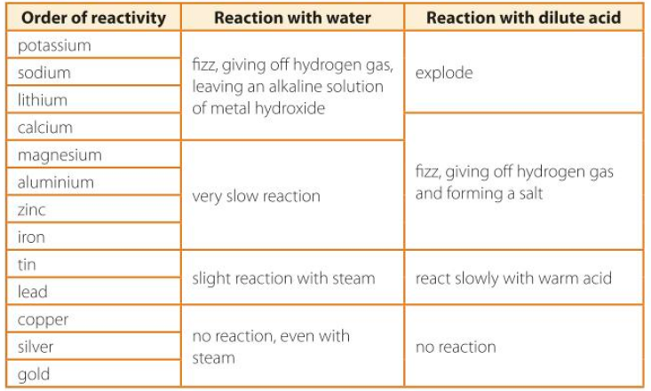
How does the reactions of group 1 metals with water compare to the reactions of transition metals with water?
Write a balanced symbol equation with state symbols to show:
tin reacting with water to form tin dioxide and hydrogen
potassium reacting with water
Challenge: Write an equation to show lithium reacting with sulphuric acid.

Slide 9
How does the reactions of group 1 metals with water compare to the reactions of transition metals with water?
Group 1 metals react more vigorously with water than transition metals
Write a balanced symbol equation with state symbols to show:
tin reacting with water to form tin dioxide and hydrogen
potassium reacting with water
Sn(s) + 2H₂O(g) → SnO₂(s) + 2H₂(g)
K(s) + H₂O(l) → KOH(aq) + H₂(g)
Challenge: Write an equation to show lithium reacting with sulphuric acid.
2Li_{(s)} + H₂SO_{4(aq)} → Li₂SO_{4(aq)} + H_{2(g)}

Slide 10
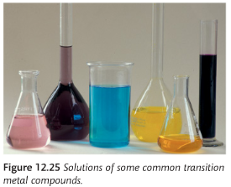
Properties of Transition Metals
The two main oxides of iron are FeO and Fe₂O₃. If the oxide ion charge doesn’t change, what is the charge of iron in each example?
What is the charge on the vanadium ion in V₂O₅? What about VO₂?
What does the information above tell you about the charges on transition metal ions?
Look at the picture of some transition metal compound solutions. What do you observe about them?
What does platinum and iron have in common? Transition metals are commonly used as what?

Slide 11
Properties of Transition Metals
The two main oxides of iron are FeO and Fe₂O₃. If the oxide ion charge doesn’t change, what is the charge of iron in each example?
FeO, Fe=2+, Fe₂O₃, Fe = 3+
What is the charge on the vanadium ion in V₂O₅? What about VO₂?
V₂O₅ V = 5+ VO₂ V = 4+
What does the information above tell you about the charges on transition metal ions? They have variable charges.
Look at the picture of some transition metal compound solutions. What do you observe about them? They form coloured compounds (the different charged ions will have different colours e.g. Fe²⁺ gives green compounds, but Fe³⁺ forms red-brown compounds)
What does platinum and iron have in common? Transition metals are commonly used as what? Catalysts (Pt for catalytic converters, Fe for the Haber process)

Slide 12
Copper (II) sulfate is blue
Nickel (II) carbonate is pale green
Chromium(III) oxide is dark green
Manganese(II) chloride is pale pink
Make a note of the colours of these compounds.
What is the charge on each transition metal ion?
What is the formula for each compound?

Slide 13
Copper (II) sulfate is blue Cu²⁺ CuSO₄
Nickel (II) carbonate is pale green Ni²⁺ NiCO₃
Chromium(III) oxide is dark green Cr³⁺ Cr₂O₃
Manganese(II) chloride is pale pink Mn²⁺ MnCl₂
Make a note of the colours of these compounds.
What is the charge on each transition metal ion?
What is the formula for each compound?

Slide 14

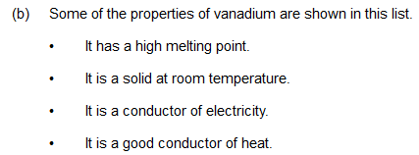


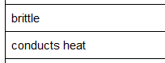




Slide 15
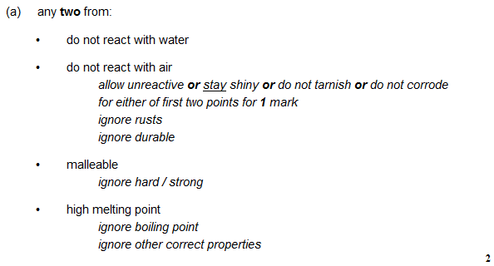
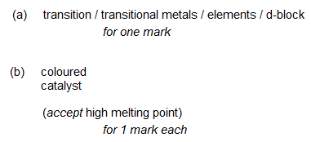

Slide 16


