Slide 1
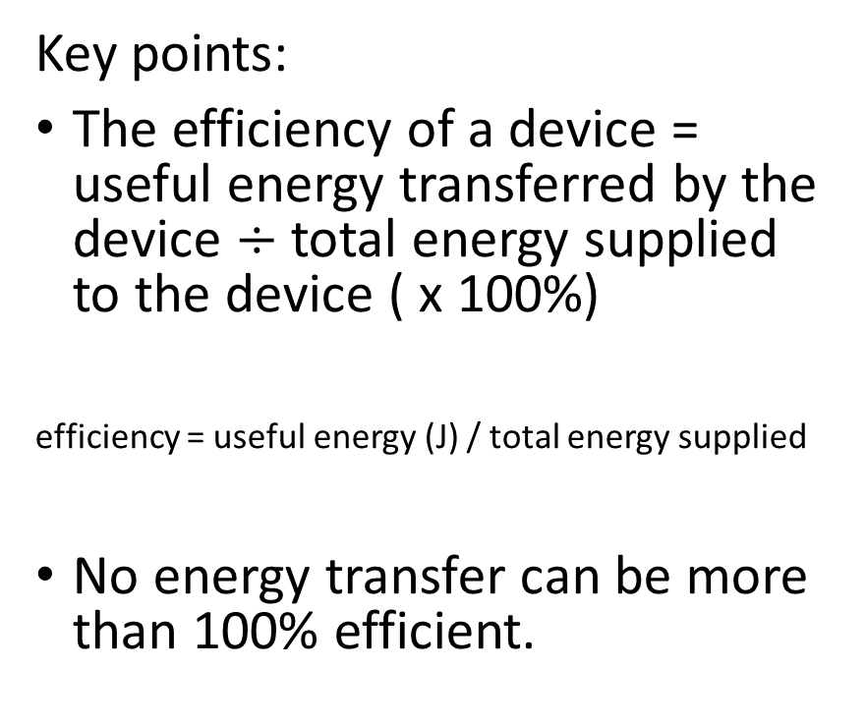
P1.7 Energy and efficiency
Key points:
The efficiency of a device = useful energy transferred by the device $÷$ total energy supplied to the device ( x 100%)
efficiency = useful energy (J) / total energy supplied
No energy transfer can be more than 100% efficient.
Machines waste energy because of the friction between their moving parts, air resistance, electrical resistance and noise
Machines can be made more efficient by reducing the energy they waste. For example, lubrication is used to reduce friction between moving parts.

Slide 2
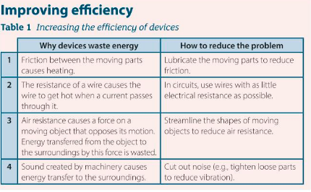
P1.7 Energy and efficiency
Notes: Record the key points. We need to appreciate Table 1 below.
Practical demo: Electric winch.
Videos to support the learning of this topic:
https://www.youtube.com/watch?v=qFQiCkVwJhE
5 minute Physics.
https://www.youtube.com/watch?v=4b8ZsFszE8I perpetual motion machine 5 minutes.
https://www.youtube.com/watch?v=auGROndZ-HA Taipei 101, energy dissipation at 30mins
Comparing metal and ceramic brake discs.

Slide 3
P1.7 Energy and efficiency
1a) Compare the useful output energy by a machine and the input energy supplied to the machine.
b) Explain why the percentage efficiency of a machine can never be:
i) > 100%.
ii) equal to 100%.
An electric motor is used to raise a weight. When you supply 60J of energy to the motor, the weight gains 24J of gravitational potential energy.
Calculate:
a) the energy wasted the motor
b) the efficiency of the motor

Slide 4
P1.7 Energy and efficiency
A machine is 25% efficient. If the total energy supplied to the machine is 3200J, calculate how much useful energy can be transferred.
An electric fan heater contains a motor that blows hot air into the room. Describe the changes in the energy stores of the heater.

Slide 5
P1.7 Energy and efficiency
1a) Compare the useful output energy by a machine and the input energy supplied to the machine.
Best done with an example, e.g. a light bulb. We want light (useful output) but inevitably get some heat out too, but this is not wanted, so is wasted. The input energy has to provide enough to cover both.
b) Explain why the percentage efficiency of a machine can never be:
> 100%.
That would break the law of Physics, that energy can neither be created nor destroyed.
ii) equal to 100%.
In transforming from one energy type to another, energy will be lost, usually as sound or heat, which cannot be recovered into a useful form of energy.
2 An electric motor is used to raise a weight. When you supply 60J of energy to the motor, the weight gains 24J of gravitational potential energy. Calculate:
a) the energy wasted the motor
Total in – useful = wasted energy
60J – 24J = 36J
b) the efficiency of the motor
Efficiency = useful/total x 100%
efficiency = 24/60 x 100 = 40%

Slide 6
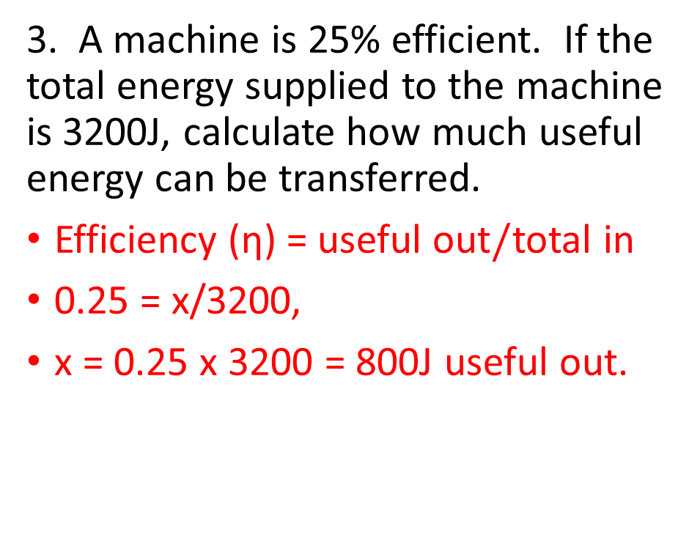
P1.7 Energy and efficiency
3. A machine is 25% efficient. If the total energy supplied to the machine is 3200J, calculate how much useful energy can be transferred.
Efficiency (η) = useful out$/$total in
0.25 = x/3200,
x = 0.25 x 3200 = 800J useful out.
An electric fan heater contains a motor that blows hot air into the room. Describe the changes in the energy stores of the heater.
Electrical energy => heat,KE, noise.
The noise is wasted.

Slide 7
P1.7 Energy and efficiency
Discussions: Efficient running. Efficient cycling. Efficient paddling. Efficient swimming.
https://www.youtube.com/watch?v=9t6Mpq8gMqM running
https://www.youtube.com/watch?v=s3HhNlysFDs swimming
https://www.youtube.com/watch?v=wMo2vGBKpl8 efficiency of motors in India
https://www.youtube.com/watch?v=ytkt2YxGou4 What Countries Are The Most Energy Efficient?
https://www.youtube.com/watch?v=67QkUaJGYGc rowing
Bring in the drill and the bicycle:
https://www.youtube.com/watch?v=fYbi26CHvew
James Prescott Joule
Show use of joulemeter and hair drier etc.
https://www.youtube.com/watch?v=G_45SWWXPlU 2018 Dutch promo – music and pictures, allows for their observations of the difference for Improving efficiency, bike and body position.
https://www.youtube.com/watch?v=0jO80yeHGw0 2.24, all you need to know about a track bike
Physics of track bikes: https://www.youtube.com/watch?v=TQdlwiLs2HA– stop at soft pedalling -- 5.00 minutes.
https://www.youtube.com/watch?v=pjLVQ3t9Bws 3.23min London velodrome natural light, insulated, efficient running costs, as well as a fast track.
https://www.youtube.com/watch?v=MVNo4EoVkXM science of an energy efficient running track,

