Slide 1
P1.8 Electrical appliances
Key points
Electricity and gas and/or oil supply most of the energy you use in your home.
Electrical appliances can transfer energy in the form of useful energy at the flick of a switch.
Uses of everyday electrical appliances include, heating, lighting, motors, and radio and TVs.
An electrical appliance is designed for a particular purpose and should waste as little energy as possible.
Video to support the learning of this lesson:
https://www.youtube.com/watch?v=gj1tu8bTKjI GCSE Science Revision Physics "Energy Transfer by Appliances“ 4:00 minutes

Slide 2
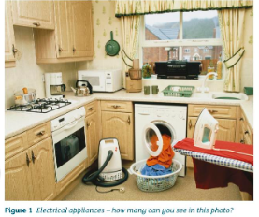
P1.8 Electrical appliances
Notes: Key points, then:
Electricity and gas and/or oil supply most of the energy in your home.
(quick show of hands – heating is it electric, gas, or oil. kitchen stove – is it electric, gas or oil?)
Electrical appliances transfer electricity into useful energy at the flick of a switch.
Efficient devices waste less energy.
Draw an illustrated spider diagram of appliances to cover: heating, lighting, vacuum cleaner, blender, sound, visual images
Figure 1 and Table 1 cover what we need to appreciate:

Slide 3
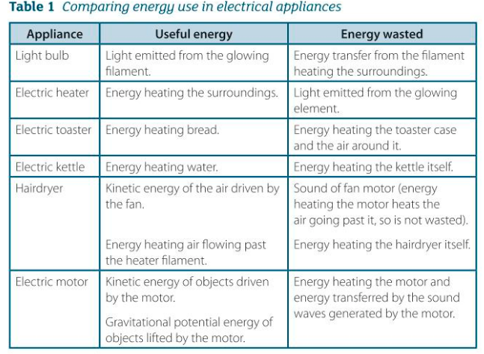
P1.8 Electrical appliances
Notes: Key points, then:

Slide 4
P1.8 Electrical appliances
1. Match each electrical appliance in the list below with the energy transfer A or B it is designed to bring about. A => sound, B => KE
a) Electric drill
b) Food mixer
c) Electric bell
2a) Explain why a clockwork radio needs to be wound up before it can be used.
2b) Describe the changes in energy stores that take place in a clockwork radio when it is wound up and then switched on.
c) Give one advantage and one disadvantage of a clockwork radio compared with a battery-operated radio.

Slide 5
P1.8 Electrical appliances
3) An electric dishwasher heats up water and sprays the hot water at the dishes. It then pumps the water out.
a) Describe how energy is usefully used in the machine.
b) Describe how energy is wasted by the machine.
4. A laptop battery stores energy with an efficiency of 80% when it is recharged from a low-voltage power supply. When it is connected to the laptop, it transfers energy to the laptop with an efficiency of 60%.
a) Calculate the overall efficiency of the laptop battery.
b) Calculate the overall percentage of the energy wasted.

Slide 6
P1.8 Electrical appliances (answers)
1. Match each electrical appliance in the list below with the energy transfer A or B it is designed to bring about. A => sound, B => KE
a) Electric drill => KE
b) Food mixer => KE
c) Electric bell => sound
2a) Explain why a clockwork radio needs to be wound up before it can be used.
Needs a store of elastic PE that can be steadily transformed into KE.
2b) Describe the changes in energy stores that take place in a clockwork radio when it is wound up and then switched on.
Chemical energy=>KE=> elastic PE => KE => electrical => sound & heat.

Slide 7
P1.8 Electrical appliances (answers)
3) An electric dishwasher heats up water and sprays the hot water at the dishes. It then pumps the water out.
a) Describe how energy is usefully used in the machine.
Electricity => heat and KE, a spray of hot water. Electrical energy => KE as the water is pumped out.
b) Describe how energy is wasted by the machine.
The dishwasher itself gets hot, and also unwanted sound is created and wasted as part of the washing process.
4. A laptop battery stores energy with an efficiency of 80% when it is recharged from a low-voltage power supply. When it is connected to the laptop, it transfers energy to the laptop with an efficiency of 60%.
a) Calculate the overall efficiency of the laptop battery.
b) Calculate the overall percentage of the energy wasted.
Say 100J is provided to the low-voltage supply. 80J of that is stored by the battery charger, and 60%, so 0.60 x 80J => laptop => 48J, so:
a) laptop battery % efficiency is: 100J in, 48J useful out = 48%.
b) Overall percentage wasted must be 52%.

