Slide 1
P1.9 Energy and Power
Key points:
Power is the rate of transfer of energy
Power = Energy / Time, P = E/t, watts = joules/second
Efficiency of an appliance:
η = useful power out/total power in (x 100%)
Power wasted by appliance = total input – useful output

Slide 2
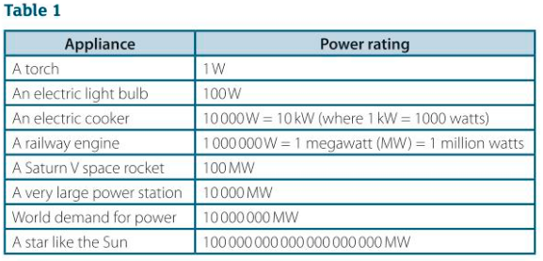
P1.9 Energy and Power
Notes:
The more powerful a device, the faster the rate that it transfers energy.
Table 1 gives values for power rating figures to the power of ten.
1MW = 1 x 10⁶ W
Videos to support the learning of this topic: James Prescott Joule: https://www.youtube.com/watch?v=fYbi26CHvew
https://www.youtube.com/watch?v=xaAjs1_WIgs
EC labelling: Power to the people

Slide 3
P1.9 Energy and Power
Worked example:
Calculate a typical power output for a human.
30 step ups in 60s. Each step 0.3m. Weight of person 700N
Power = work done/time, which is PE gain/ time
Which is: mgh/time,
Where: h = height of step x number of step ups, weight = mg
Power = (700 x 0.3 x 30)/60 = 105W
Examples: Torch 1W, modern light bulb 20W, a very large power station 10 000MW, 10 GW
https://en.wikipedia.org/wiki/List_of_power_stations_in_England

Slide 4
P1.9 Energy and Power
1a) State which of the following is most powerful:
i) A torch bulb or a mains filament lamp?
ii) A 3kW electric kettle or a 10000W electric cooker?
1b) There are about 20 million occupied homes in England. If a 3kW electric kettle was switched on in 1 in 10 homes at the same time, work out how much power would need to be supplied.
2. The total power supplied to a lift motor is 5000W. In a test, the motor transfers 12000J of energy in 20s to the gravitational PE store of the lift.
a) Calculate how much energy is supplied to the motor by the current through it in 20s.
b) Calculate its efficiency in the test

Slide 5
P1.9 Energy and Power
3. A machine has an input power rating of 100kW. If the useful energy transferred by the machine in 50s is 1500kJ, calculate:
a) its output power in kilowatts
b) its percentage efficiency.
4a) Describe the energy transfers and changes to the energy stores of an electric hot water shower when it is operation. [5 marks!]
4b) A 12kW electric shower is used 4 times a day for 20 minutes each time. Calculate the electricity supplied to it by electricity in one day.

Slide 6
P1.9 Energy and Power (answers)
1a) State which of the following is most powerful:
i) A torch bulb or a mains filament lamp?
A mains filament lamp (1W<100W)
ii) A 3kW electric kettle or a 10000W electric cooker?
Cooker, as 10kW>3kW
1b) There are about 20 million occupied homes in England. If a 3kW electric kettle was switched on in 1 in 10 homes at the same time, work out how much power would need to be supplied.
1 in 10 of 20M => 2 000 000, times 3kW => 6000MW.
2. The total power supplied to a lift motor is 5000W. In a test, the motor transfers 12000J of energy in 20s to the gravitational PE store of the lift.
a) Calculate how much energy is supplied to the motor by the current through it in 20s.
E = P x t, = 5000 x 20 = 100 000J
b) Calculate its efficiency in the test
ƞ = useful/total x 100%
Ƞ = 12000/100000 x 100% = 12%

Slide 7
P1.9 Energy and Power
3. A machine has an input power rating of 100kW. If the useful energy transferred by the machine in 50s is 1500kJ, calculate:
a) its output power in kilowatts
Useful out P=E/t,
P = 1500kJ/50 = 30kW
b) its percentage efficiency.
Ƞ = useful / total x 100
= 30kW/100kW) x 100 = 30%
4a) Describe the energy transfers and changes to the energy stores of an electric hot water shower when it is operation. [5 marks!]
1: Electrical to heat
2: Electrical to KE, pump
3: KE to PE, water pump up and out of shower head.
4: GPE => KE as water falls
5: Heat energy of water lost to air as energy dissipates into bathroom.

Slide 8
P1.9 Energy and power
4b) A 12kW electric shower is used 4 times a day for 20 minutes each time. Calculate the electricity supplied to it by electricity in one day.
Energy = power x time
E = 4 x (12kW x (20 x 60)s)
E = 57600kJ

