Slide 1
Algebra skills
Mathematics for GCSE Science

Slide 2
Objectives
Understand and use the symbols: =, <, <<, >>, >, ∝, ~
Change the subject of an equation
Substitute numerical values into algebraic equations using appropriate units for physical quantities
Solve simple algebraic equations

Slide 3
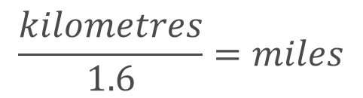

Introduction
Algebra is used in many different aspects of Science and Maths.
Here is an example of a useful algebraic formula:
$$kilometres = 1.6 × miles$$
By rearranging this formula, we could figure out miles in terms of kilometres:
$$\frac{kilometres}{1.6}=miles$$
Over the course of this presentation, you will learn the key facts of algebra and how to use it.

Slide 4













The symbols of algebra
Symbols are used in algebra to show the relationships between variables.
$$x$$
Unknown value
$$=$$
Equal to
Eg $x=6$
$$<$$
Less than
$$>$$
Greater than
$$≪$$
Much less than
$$≫$$
Much greater than
Eg $x<3x<<50x$ for $x>0$
Eg $50x>>3x>x$for $x>0$
$$\sim$$
Weak approximation
Eg $3.5π\sim 10$
$$∝$$
Proportional to
Eg $y∝x$

Slide 5

What are formulae?
Formulae describe the relationships between things, such as temperature measured in degrees Fahrenheit and degrees Celsius.
  $$F=\frac{9}{5}×C+32$$
They usually use variables (letters) but they can use words:
$$speed=distance÷time$$
The key skills are changing the subjects of equations, substitution of values into equations, and ultimately solving equations.

Slide 6


Solving equations
There are a few vital tools we can use to solve equations, which will be introduced over the next few slides.
The key idea is to unravel the thread of an equation, to get it to its simplest form.
We need to remember that operations must be performed on both sides of the equation, to keep it balanced.
If we want to add 5 to the left hand side in order to isolate x, we must also add it to the right,
$$x − 5= y +2$$
$$x= y + 7$$

Slide 7
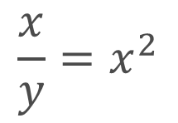
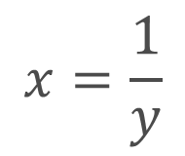

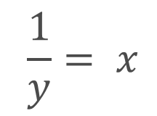
Rearranging equations to change the subject
You are given the following equation, and asked to give it in terms of $x$. This means isolating $x$ on one side of the equation.
$$\frac{x}{y}{=x}^{2}$$
If we divide both sides by $x$
$$\frac{1}{y}= x$$
$$x=\frac{1}{y}$$
This basic technique forms the basis of all equation solving.
Note that dividing by x means x cannot be zero.

Slide 8



Simplifying
Expressions (collections of numbers and letters) can often be simplified. This is called collection of like terms.
$$3x−4+9x+2$$
The $x$ terms can be collected, as can the figures.
$$3x+9x−4+2$$
This simplifies to ...
$$12x−2$$
You must pay attention to the sign before each term, to see whether it is positive or negative.

Slide 9




Simplifying in practice
Simplify the following expression, by collecting like terms:
$$3x+7y−9−12y+x+2$$
We first identify which terms are alike ...
$$3x+7y−9−12y+x+2$$
And then collect them ...
$$3x+x+7y−12y−9+2$$
This simplifies to …
$$4x−5y−7$$

Slide 10

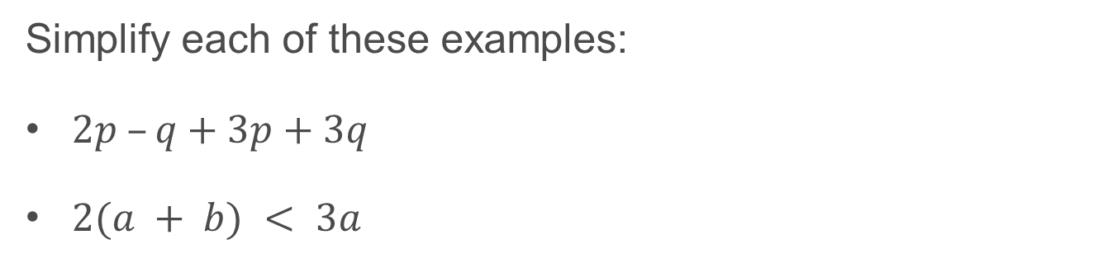

Simplifying - One step beyond…
Simplify each of these examples:
$2p –q+3p+3q$
$2(a + b) < 3a$
$$5p+2q$$
$$2b<a$$

Slide 11





Solving using simplification
Solve $3x−7=x+5$, and find the value of $x$:
$$3x−7=x+5$$
The aim is to isolate $x$ on one side of the equation
$$3x−7=x+5$$
$$2x−7=5$$
Subtract x from both sides
$$2x=12$$
Add 7 to both sides
$$x=6$$
Divide both sides by 2

Slide 12

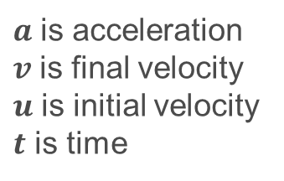
Substituting numbers into equations
Algebraic formula become really useful when we can use them to derive values. We can substitute numbers into expressions.
The equation for acceleration can be represented as …
$$a=(v –u)÷t$$
$a$ is acceleration
$v$ is final velocity
$u$ is initial velocity
$t$ is time

Slide 13

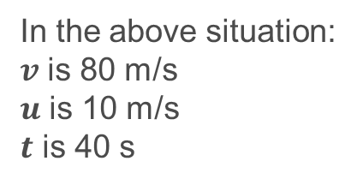


Substituting numbers into equations
In a period of 40 seconds, a car’s initial velocity was 10 m/s, and its final velocity was 90 m/s. Give its acceleration in m/s², using the above formula.
In the above situation:
$v$ is 80 m/s
$u$ is 10 m/s
$t$ is 40 s
We substitute these values into the above formula:
$$a=(90–10)÷40$$
$$a=80÷40$$
$$a=2$$
The acceleration is 2 m/s^{2.}

Slide 14
Using algebra
An app costs £1.79 for the initial download, and then charges £0.79 for each in-game purchase.
Write down a formula for the cost C of downloading this game and making n in game purchases.
It costs £1.79 + £0.79 to download the game and make 1 purchase.
It costs £1.79 + (2 × £0.79) to download the game and make 2 purchases.
It costs £1.79 + (3 × £0.79) to download the game and make 3 purchases.
Therefore the cost C of downloading this game and making n in game purchases is £1.79 + (n × £0.79)
C = £1.79 + (n × £0.79)
This formula can now be used to work out the cost of downloading the game and making any number of purchases, by substituting different values into n.

Slide 15
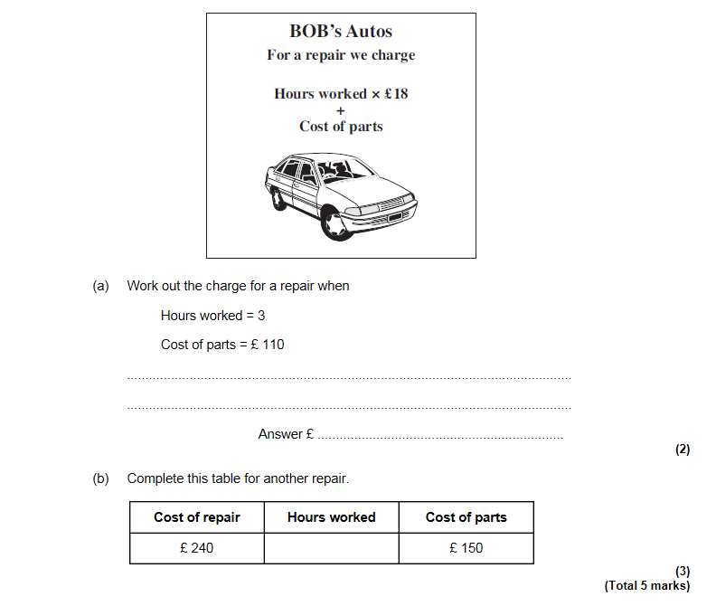
Some questions to try from Exampro
GCSE Maths F

Slide 16
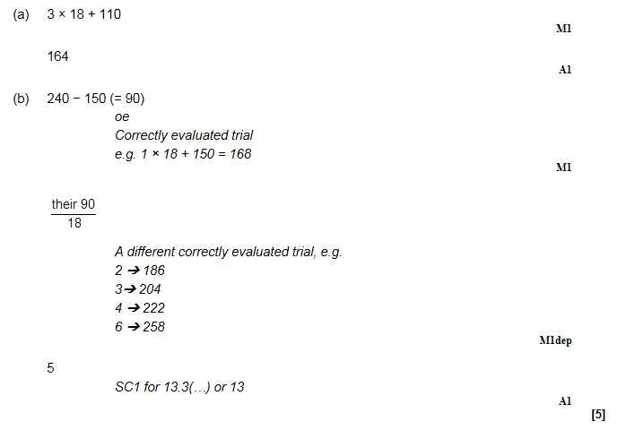
GCSE Maths F

Slide 17
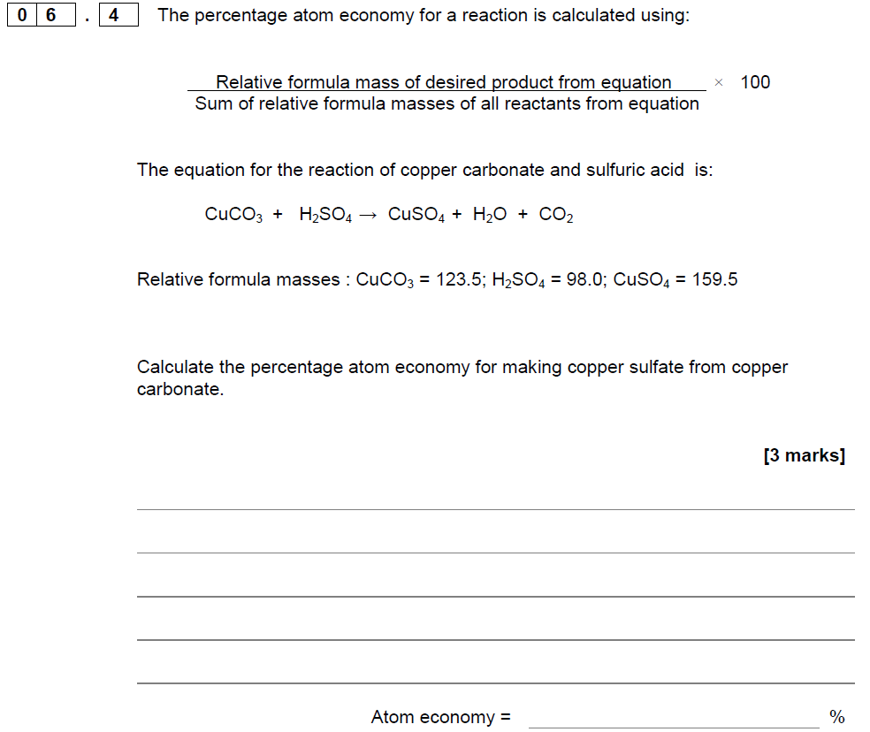
GCSE Chemistry sample assessment materials

Slide 18
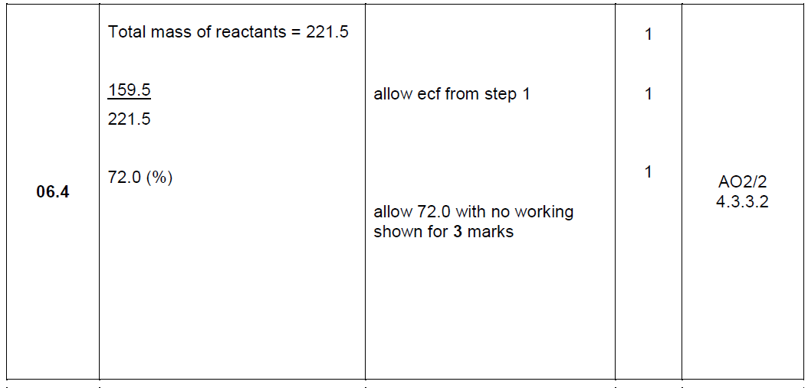
GCSE Chemistry sample assessment materials

Slide 19
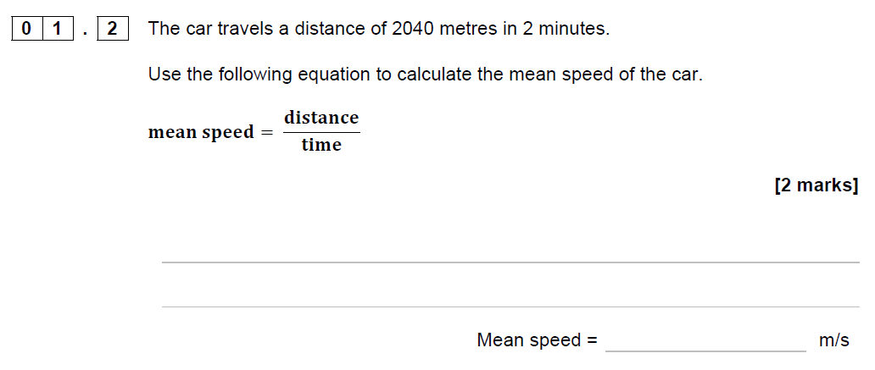
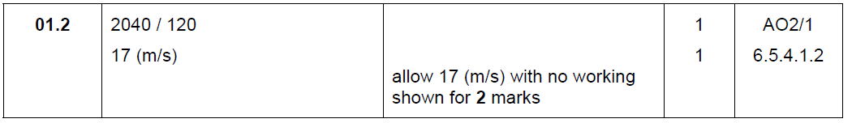
GCSE Physics sample assessment materials

Slide 20
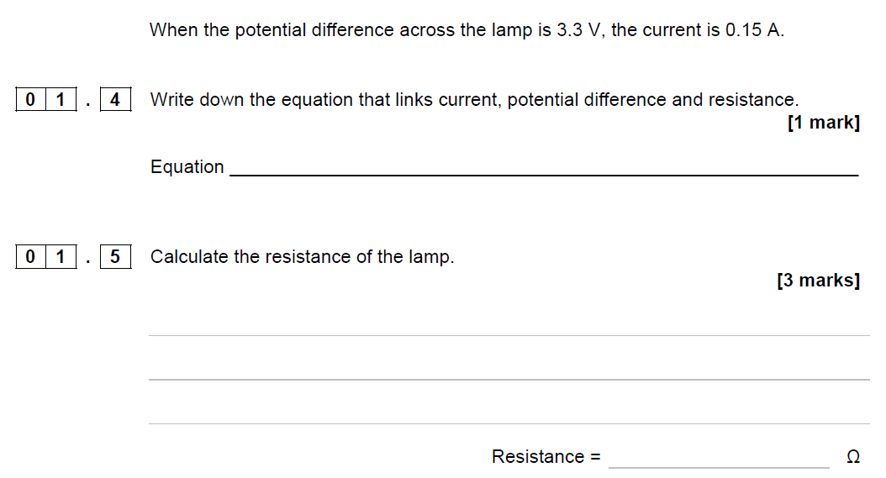
GCSE Physics sample assessment materials

Slide 21
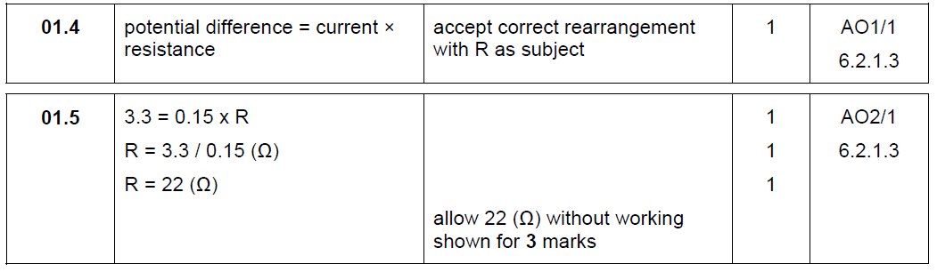
GCSE Physics sample assessment materials

Slide 22
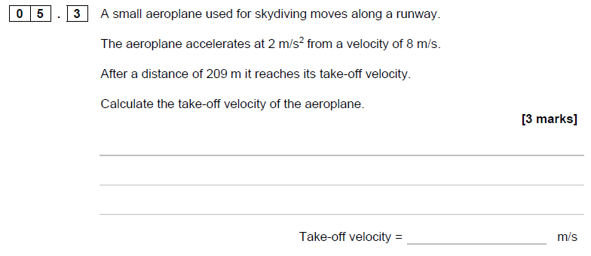
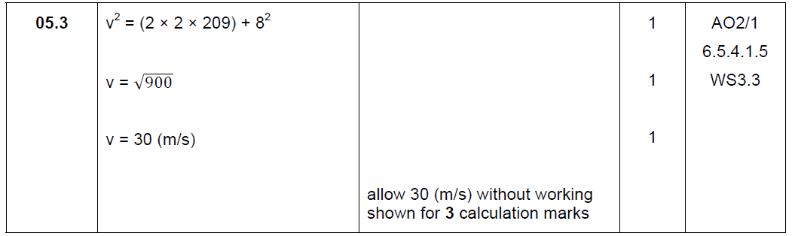
GCSE Physics sample assessment materials

