Slide 1
Estimates and significant figures
Mathematics for GCSE Science
This presentation covers these Maths skills:
make estimates of the results of simple calculations
use an appropriate number of significant figures.

Slide 2
Why do we round?
Any suggestions?
To avoid writing irrelevant figures.
For simplicity, when greater precision is not necessary, e.g. for large numbers such as populations.
To make large or complicated calculations easier (usually when calculators are not available).
Rounding and estimating are two ways to make numbers easier to manage.
Rounding is a useful tool in estimation of large or difficult problems, and plays a part in finding significant figures.

Slide 3
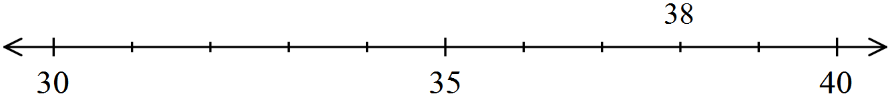
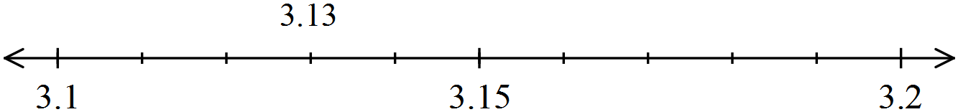
What are the rules?
You use a number line to see which end is nearer.
38 rounds to 40 to the nearest 10 as it is nearer 40 than 30.
3.13 rounds to 3.1, to 1 decimal place, as it is nearer 3.1 than 3.2.
3.15 rounds to 3.2, to 1 decimal place, because we have a convention that says round up for the halfway point. That way everybody does the same thing.

Slide 4
What is a significant figure?
A number’s significant figures are the ones that affect the size of the number most – the significant ones in terms of its size!
Non-zero digits are ALWAYS significant
Zeroes BETWEEN non-zero digits are significant.
Leading zeroes are NEVER significant.
Zeroes TO THE RIGHT of the last non-zero digit can be significant.
We will be applying these rules in the following slides, so make a note…

Slide 5
Identifying significant figures
Can you number the significant figures?
3.28034
1st
2nd
3rd
4th
5th
6th
What about this one?
0.00760
1st
2nd
3rd

Slide 6
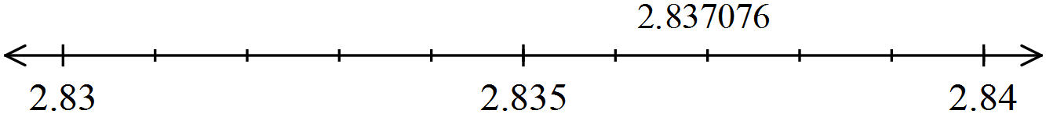
Rounding in practice
Number the significant figures
Round 2.837076 to 3 s.f.
1st 2nd 3rd 4th 5th 6th 7th
2.837076
There are two options:
2.83
2.84
REMEMBER:
We need to look at the following figure – that tells us which end the number is nearer.
Imagine 2.837076 on a number line
It lies between 2.83 and 2.84.
it is nearer 2.84, so we choose the right-hand end
2.837076 to 3 s.f. is 2.84

Slide 7
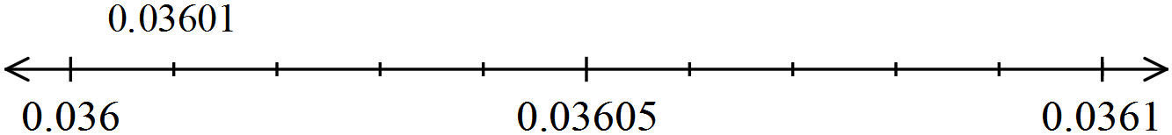
Rounding in practice
Number the significant figures…
Round 0.03601 to 3 s.f.
1st 2nd 3rd 4th
0.03601
There are two options:
0.0360
0.0361
REMEMBER:
We need to look at the following figure – that tells us which end the number is nearer.
Imagine 0.03601 on a number line
It lies between 0.0360 and 0.0361.
It is nearer 0.0360, so we choose that
0.03601 to 3s.f. is 0.0360

Slide 8
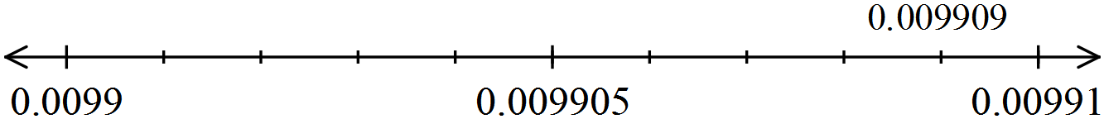
Rounding in practice
Number the significant figures…
Round 0.009909 to 3 s.f.
1st 2nd 3rd 4th
0.009909
There are two options:
0.00990
0.00991
REMEMBER:
We need to look at the following figure– that tells us which end the number is nearer.
Imagine 0.009909 on a number line
It lies between 0.00990 and 0.00991
It is nearer 0.00991, so we choose that
0.009909 to 3s.f. is 0.00991

Slide 9
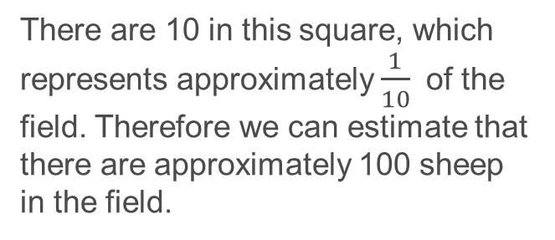
Why do we estimate?
We estimate to generate an answer, precise enough to be useful.
It is not the same as guessing!
In a field full of sheep which are fairly evenly distributed…
They are moving, and impossible to count!
We can count the number in a small area, and scale it up.
There are 10 in this square, which represents approximately $\frac{1}{10}$of the field. Therefore we can estimate that there are approximately 100 sheep in the field.

Slide 10
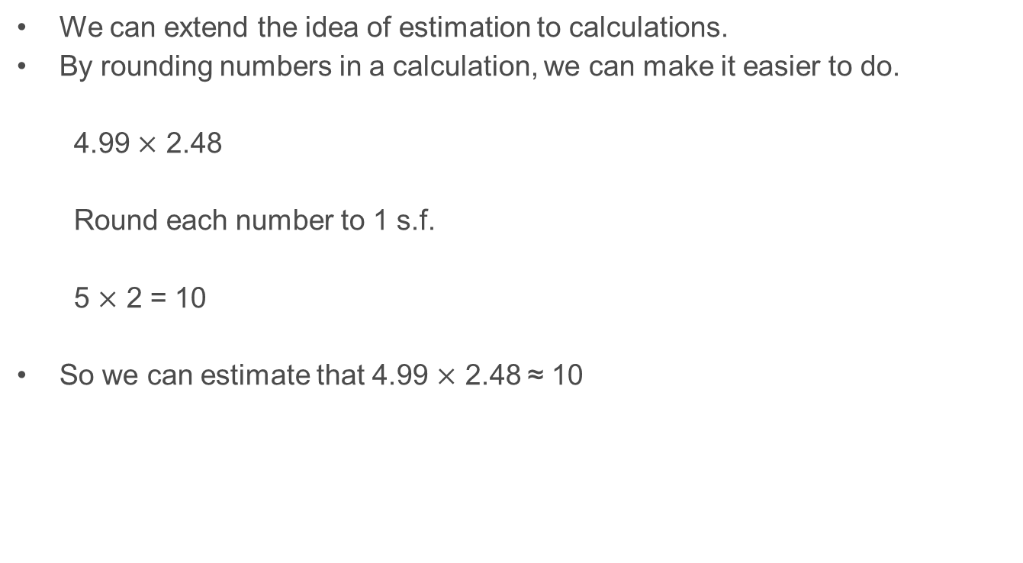
Estimation
We can extend the idea of estimation to calculations.
By rounding numbers in a calculation, we can make it easier to do.
4.99 $×$ 2.48
Round each number to 1 s.f.
5 $×$ 2 = 10
So we can estimate that 4.99 $×$ 2.48 ≈ 10

Slide 11
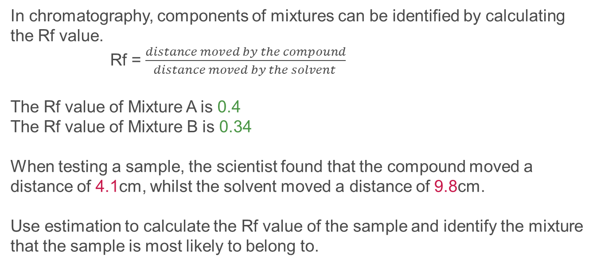

Estimation in practice
In chromatography, components of mixtures can be identified by calculating the Rf value.
Rf = $\frac{distance moved by the compound}{distance moved by the solvent }$
The Rf value of Mixture A is 0.4
The Rf value of Mixture B is 0.34
When testing a sample, the scientist found that the compound moved a distance of 4.1cm, whilst the solvent moved a distance of 9.8cm.
Use estimation to calculate the Rf value of the sample and identify the mixture that the sample is most likely to belong to.
Rf = $\frac{4.1}{9.8}\text{≈}\frac{4}{10}\text{≈}$0.4
The sample is most likely to belong to Mixture A.

Slide 12
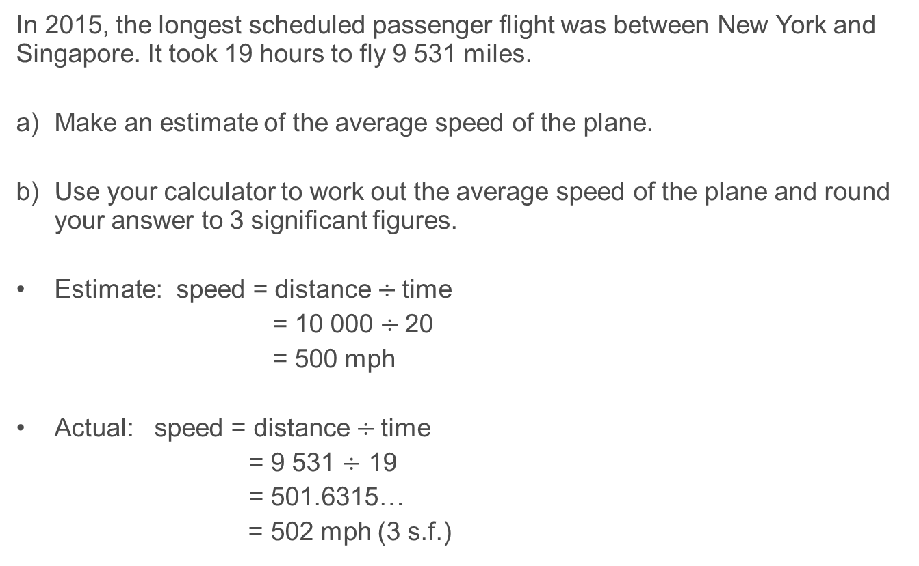
Application of estimation and significant figures
In 2015, the longest scheduled passenger flight was between New York and Singapore. It took 19 hours to fly 9 531 miles.
Make an estimate of the average speed of the plane.
Use your calculator to work out the average speed of the plane and round your answer to 3 significant figures.
Estimate: speed = distance $÷$time
= 10 000 $÷$20
= 500 mph
Actual: speed = distance $÷$time
= 9 531 $÷$ 19
= 501.6315…
= 502 mph (3 s.f.)

Slide 13
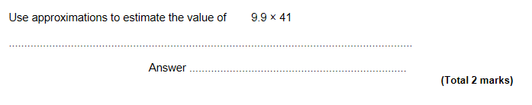
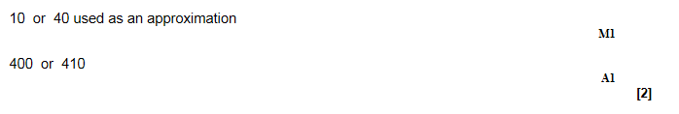
Some questions to try from Exampro
GCSE Maths F

Slide 14
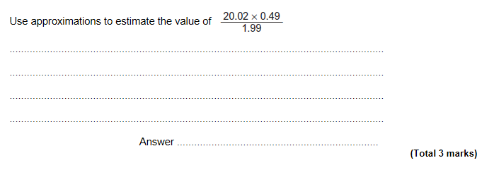
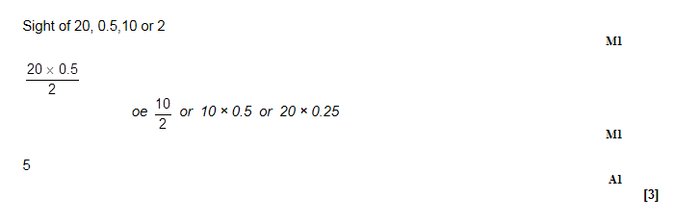
GCSE Maths F

Slide 15
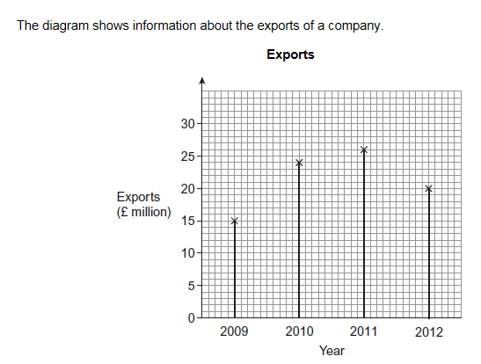
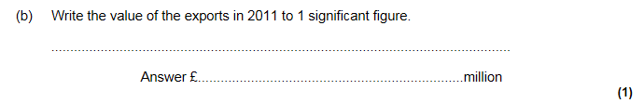

GCSE Maths F

Slide 16
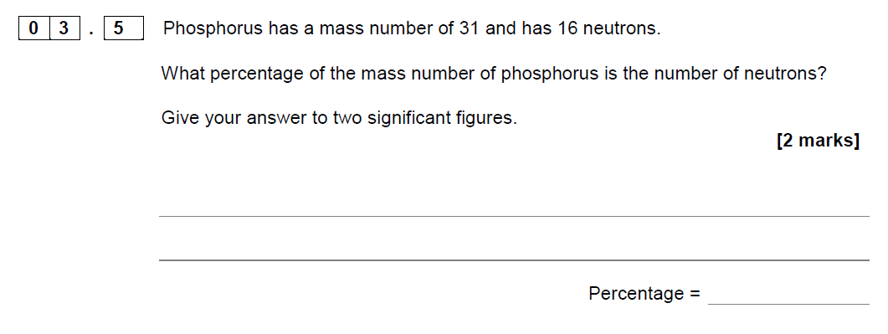
GCSE Chemistry sample assessment materials

Slide 17
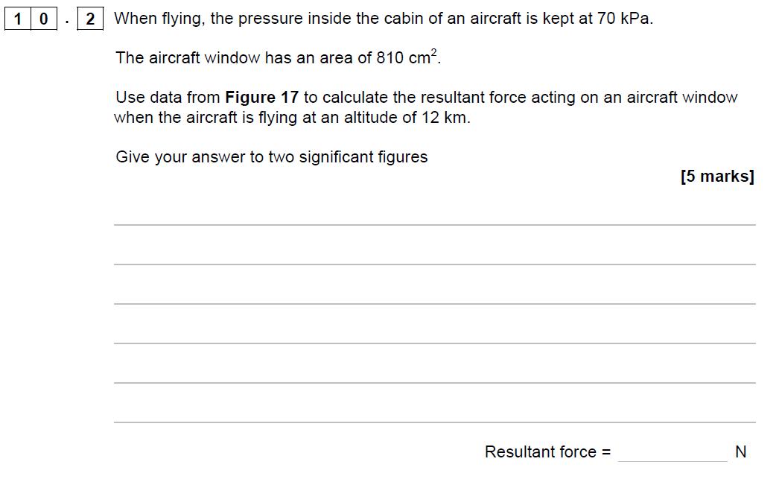
GCSE Physics sample assessment materials

Slide 18
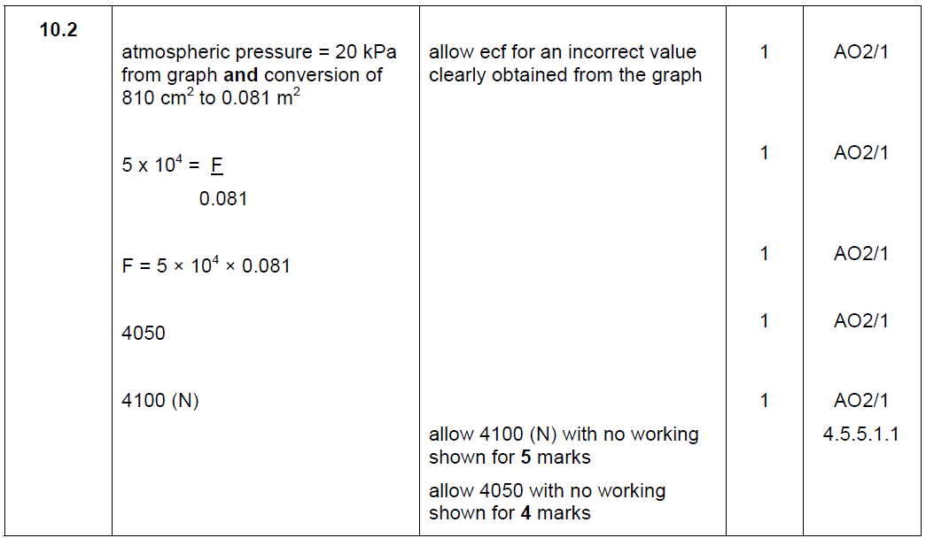
GCSE Physics sample assessment materials

