Slide 1
Standard form and order of magnitude calculations
Mathematics for GCSE Science
This presentation covers these Maths skills:
recognise and use expressions in decimal form
recognise and use expressions in standard form
make order of magnitude calculations.

Slide 2
Standard form and order of magnitude
Numbers which are very small or very large can be hard to work with. They can seem meaningless, and are hard to compare.
With figures like these, it’s hard to relate them to each other.
This lesson focuses on two ways in which these numbers can be made manageable, and hence useful:
standard form
order of magnitude.
The Earth’s diameter is 12 000 km
The diameter of a pea is 1 cm
Copyright © AQA and its licensors. All rights reserved.

Slide 3
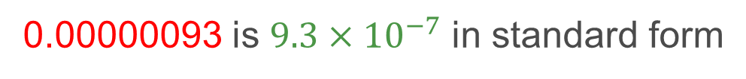
Standard form
Standard form, (or standard index form), is useful when using very large or very small numbers.
It helps us to easily manage them.
0.00000093 is $9.3×{10}^{−7}$ in standard form
There are two components
of standard form:
The digit number
The exponential number
Copyright © AQA and its licensors. All rights reserved.

Slide 4

Standard form
Standard form is written in terms of powers of 10.
The power of 10 shows the multiplying factor. It shows how many times the digits are multiplied by 10. The digits shift one place for each power of 10 to give the number in decimal form.
Negative powers means you divide by 10 that many times.
All of the significant figures in a number should be in the digit number of standard form.
Negative powers shift the digit to the right
Positive powers shift the digit to the left
$$36 852 = 3.6852×104$$
Copyright © AQA and its licensors. All rights reserved.

Slide 5
Positive powers of 10
10¹ =
10
Copyright © AQA and its licensors. All rights reserved.

Slide 6
Positive powers of 10
10³ =
1000
Copyright © AQA and its licensors. All rights reserved.

Slide 7
Positive powers of 10
10⁷ =
10000000
Copyright © AQA and its licensors. All rights reserved.

Slide 8
Negative powers of 10
10⁻³ =
0.001
Copyright © AQA and its licensors. All rights reserved.

Slide 9
Negative powers of 10
10⁻⁷ =
0.0000001
Copyright © AQA and its licensors. All rights reserved.

Slide 10
Bonus question
10⁰ =
1
Copyright © AQA and its licensors. All rights reserved.

Slide 11

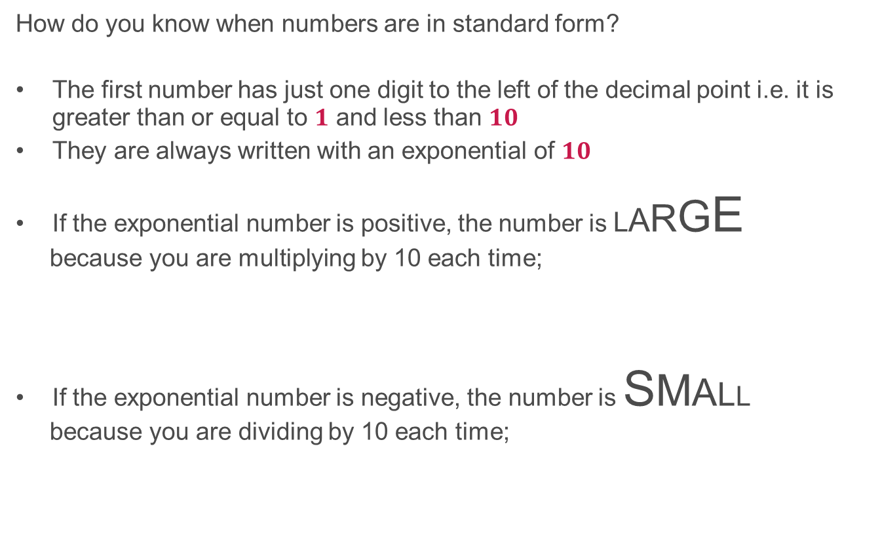

Standard form rules
How do you know when numbers are in standard form?
The first number has just one digit to the left of the decimal point i.e. it is greater than or equal to $1$ and less than $10$
They are always written with an exponential of $10$
If the exponential number is positive, the number is LARGE
because you are multiplying by 10 each time;
If the exponential number is negative, the number is SMALL
because you are dividing by 10 each time;
$${\text{2.3}×10}^{7}=23 000 000$$
$${\text{2.3}×10}^{−7}=\text{0.00000023}$$
Copyright © AQA and its licensors. All rights reserved.

Slide 12
Converting to standard form
The distance between the Sun and Earth is approximately 149 million km. Convert this number to standard form.
There are two parts to standard form figures:
the digit number
the exponential number.
Remember - the digit number is ALWAYS greater than or equal to 1 and less than $10$
For this example, the digit number should be $1.49$
Now for the exponential number
149 million km = 149000000km
12345678
Count the digits after 1 because that is how many times you multiply by 10.
So 149 million km in standard form is $1.49×{10}^{8}$km.
Copyright © AQA and its licensors. All rights reserved.

Slide 13
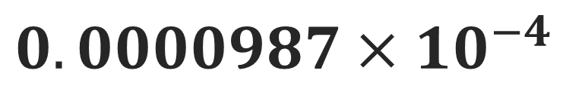
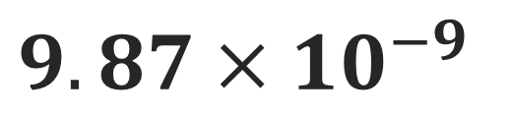
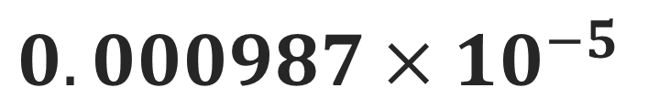
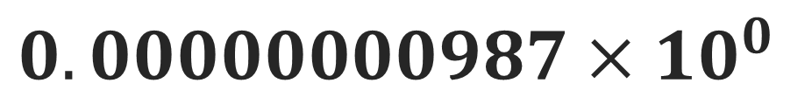
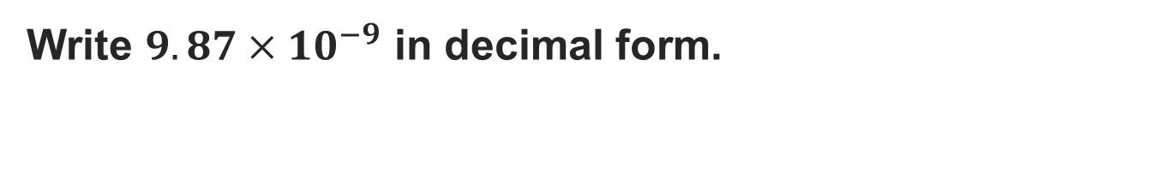
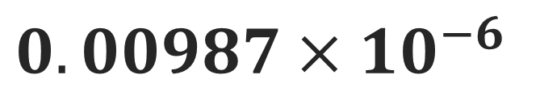
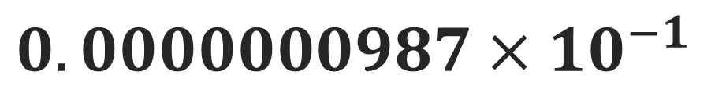
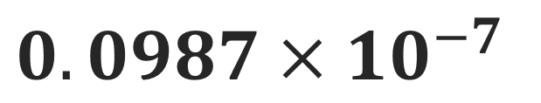

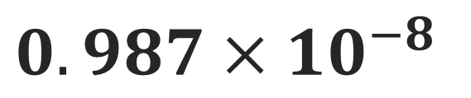
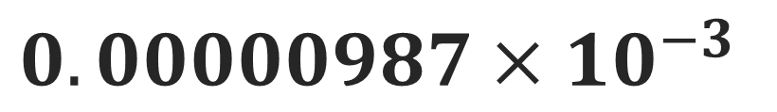
Converting standard form
Write ${9.87×10}^{−9}$ in decimal form.
The exponential indicates how many times the digit number should by multiplied or divided by 10, depending on the positive/negative power of 10.
In this example, it is divided by 10 nine times to make it smaller;
$${0.000987×10}^{−5}$$
$${0.00000000987×10}^{0}$$
$${0.0000000987×10}^{−1}$$
$${0.000000987×10}^{−2}$$
$${0.00000987×10}^{−3}$$
$${0.00987×10}^{−6}$$
$${0.987×10}^{−8}$$
$${9.87×10}^{−9}$$
$${0.0000987×10}^{−4}$$
$${0.0987×10}^{−7}$$
$$0.00000000987$$
Copyright © AQA and its licensors. All rights reserved.

Slide 14
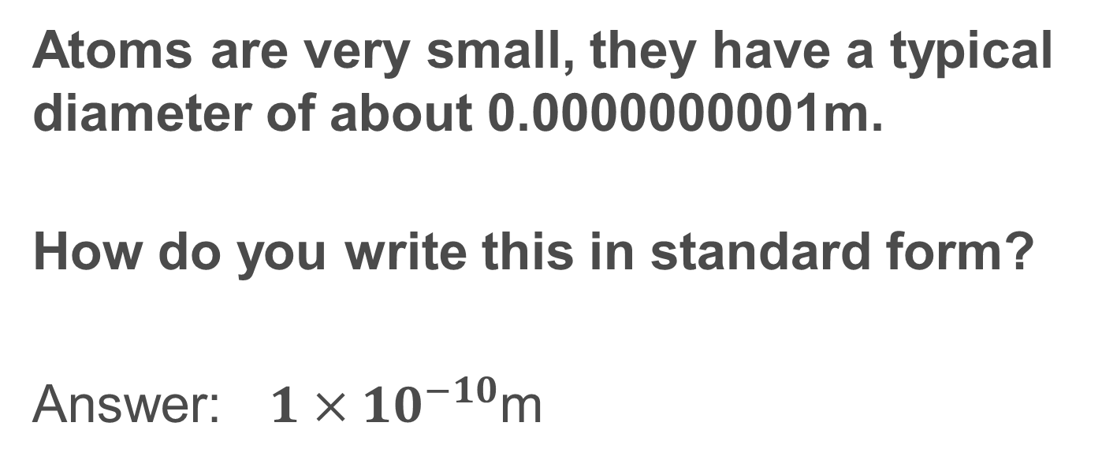
Question 1
Atoms are very small, they have a typical diameter of about 0.0000000001m.
How do you write this in standard form?
Answer: $1×{10}^{−10}$m
Copyright © AQA and its licensors. All rights reserved.

Slide 15
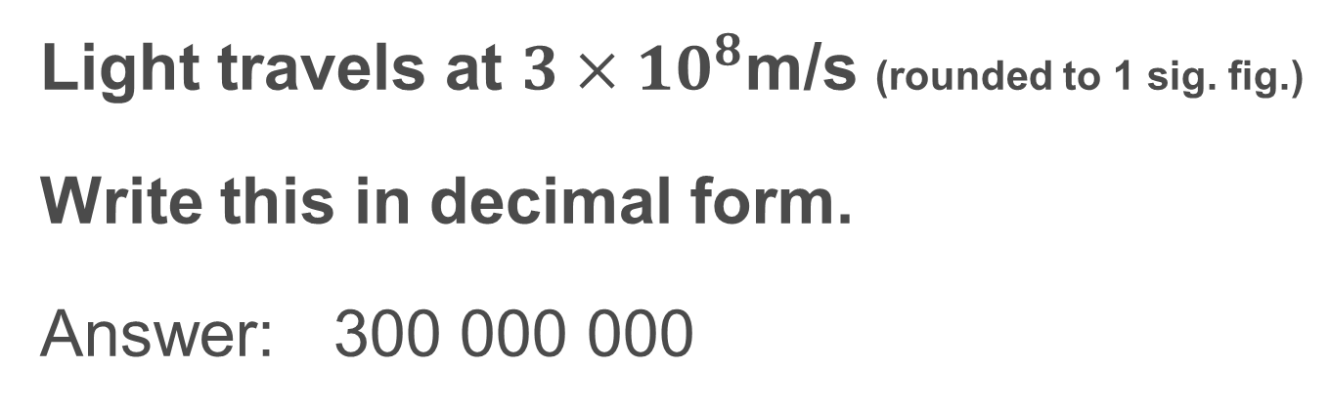
Question 2
Light travels at $3×{10}^{8}$m/s (rounded to 1 sig. fig.)
Write this in decimal form.
Answer: 300 000 000
Copyright © AQA and its licensors. All rights reserved.

Slide 16
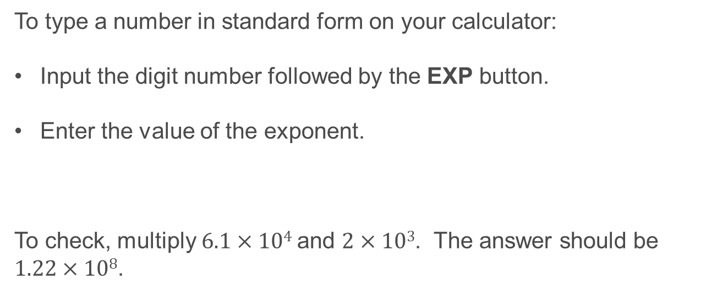
Standard form calculations on your calculator
To type a number in standard form on your calculator:
Input the digit number followed by the EXP button.
Enter the value of the exponent.
To check, multiply $6.1×104$and $2×103$. The answer should be $1.22×108$.
Copyright © AQA and its licensors. All rights reserved.

Slide 17
What are orders of magnitude?
Orders of magnitude allow us to compare very large and very small values to each other. This comes in useful in Physics when comparing the range of subatomic particles or sizes of planets.
An order of magnitude is a division or multiplication by 10. Each division or multiplication by ten is termed an order of magnitude. The actual length may be approximated as it is the relative difference which is important.
The order of magnitude means something is 10 times bigger or 100 times smaller.
Copyright © AQA and its licensors. All rights reserved.

Slide 18
Orders of magnitude
The order of magnitude of a number is the number of powers of 10 contained in the number.
The order of magnitude of 10 is 1. The order of magnitude of 1 000 is 3.
Two numbers can be said to have the same order of magnitude if the large one divided by the small one is less than 10
This means that 56 and 18 have the same order of magnitude, but 560 and 18 do not.
Copyright © AQA and its licensors. All rights reserved.

Slide 19
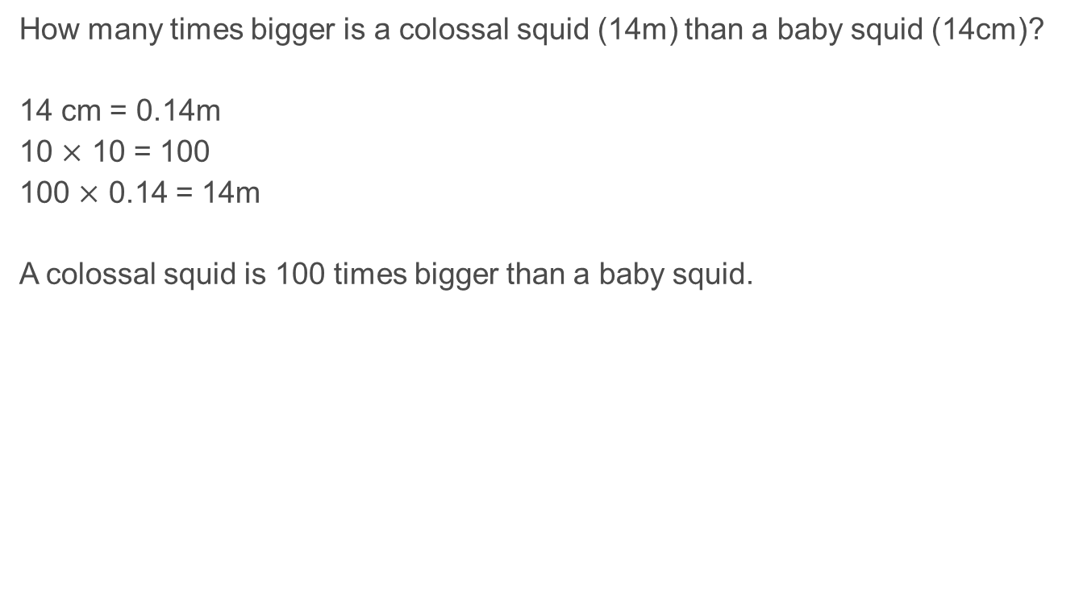
Orders of magnitude in practice
How many times bigger is a colossal squid (14m) than a baby squid (14cm)?
14 cm = 0.14m
10 $×$ 10 = 100
100 $×$ 0.14 = 14m
A colossal squid is 100 times bigger than a baby squid.
Copyright © AQA and its licensors. All rights reserved.

Slide 20

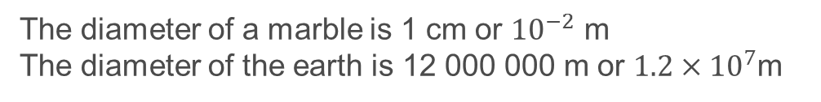
Orders of magnitude and standard form
We can compare orders of magnitude easily using standard form.
The diameter of a marble is 1 cm or ${10}^{−2}$ m
The diameter of the earth is 12 000 000 m or $1.2×{10}^{7}$m
We can compare these two diameters by dividing the larger power of 10 by the smaller one.
$${10}^{7}÷{10}^{−2}={10}^{9}$$
The diameter of the earth is 1 000 000 000 times bigger than that of a marble.
Copyright © AQA and its licensors. All rights reserved.

Slide 21
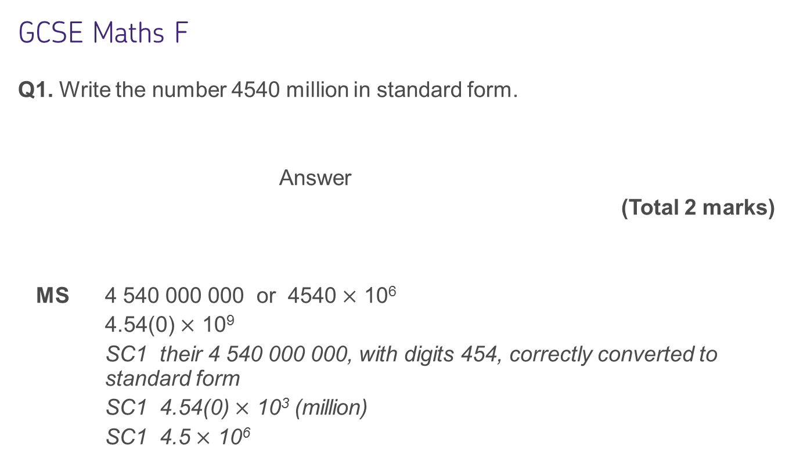
Some questions to try from Exampro
GCSE Maths F
Q1. Write the number 4540 million in standard form.
Answer
(Total 2 marks)
MS 4 540 000 000 or 4540 $×$ 10⁶
4.54(0) $×$ 10⁹
    SC1 their 4 540 000 000, with digits 454, correctly converted to standard form
SC1 4.54(0) $×$ 10³ (million)
SC1 4.5 $×$ 10⁶
Copyright © AQA and its licensors. All rights reserved.

Slide 22
GCSE Maths F
Q2. (a) Write 0.00072 in standard form.
Answer
(1)
(b) Divide 80 million by 20 000
Write your answer in standard form.
Answer
(3)
(Total 4 marks)
Copyright © AQA and its licensors. All rights reserved.

Slide 23
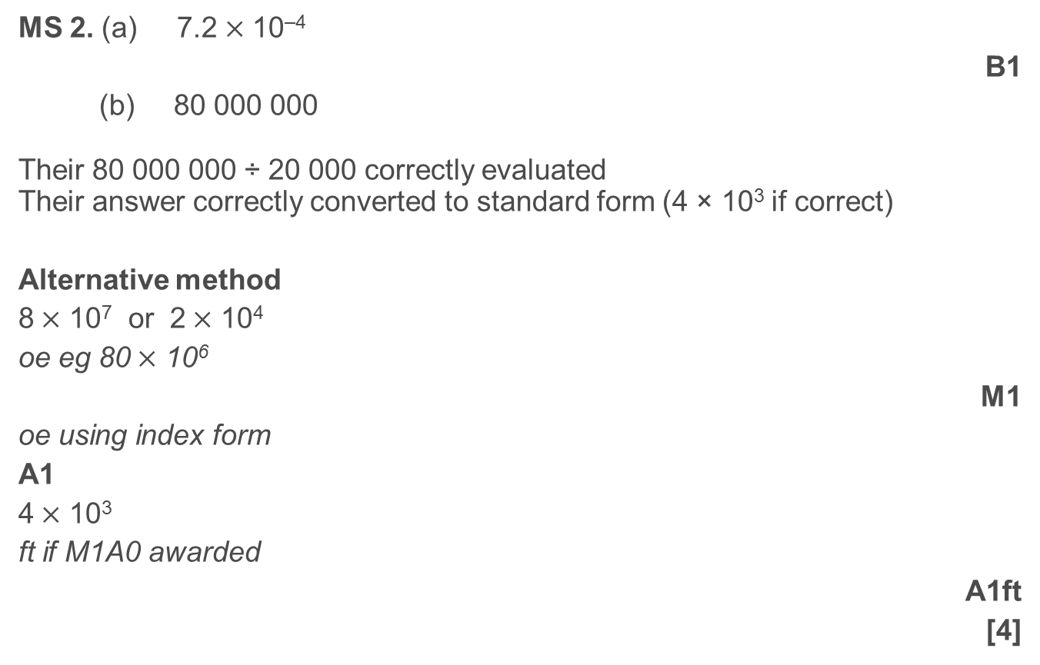
MS 2. (a) 7.2$×$ 10^{–4}
B1
(b) 80 000 000
Their 80 000 000 ÷ 20 000 correctly evaluated
Their answer correctly converted to standard form (4 × 10³ if correct)
Alternative method
8$×$ 10⁷ or 2$×$ 10⁴
oe eg 80$×$ 10⁶
M1
oe using index form
A1
4$×$ 10³
ft if M1A0 awarded
A1ft
[4]
Copyright © AQA and its licensors. All rights reserved.

Slide 24
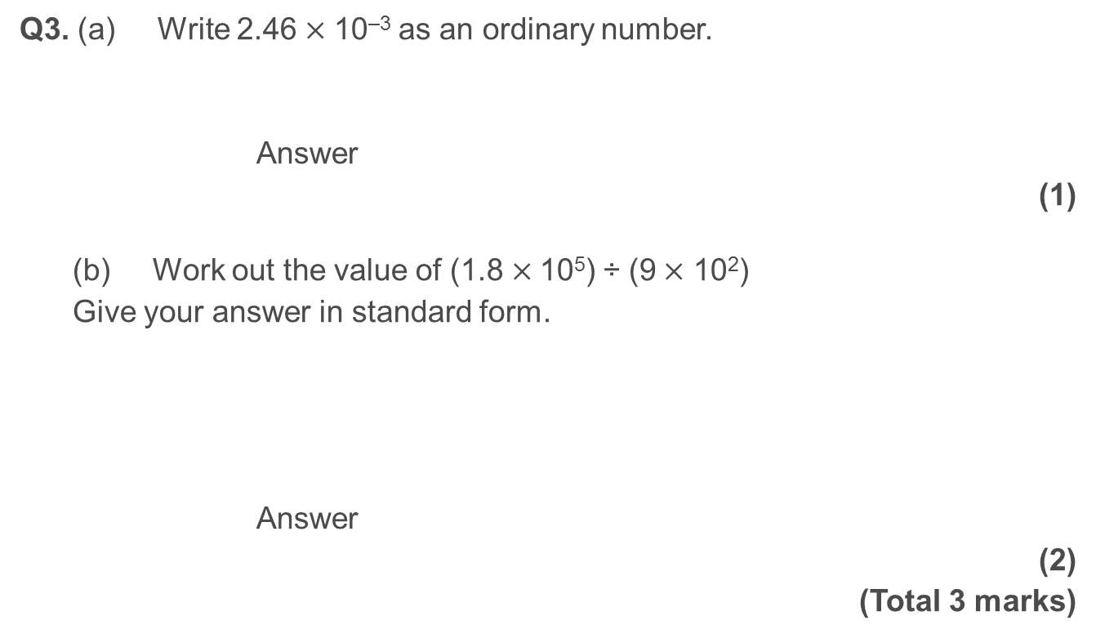
GCSE Maths F
Q3. (a) Write 2.46$×$ 10^{–3} as an ordinary number.
Answer
(1)
(b) Work out the value of (1.8$×$ 10⁵) ÷ (9$×$ 10²)
Give your answer in standard form.
Answer
(2)
(Total 3 marks)
Copyright © AQA and its licensors. All rights reserved.

Slide 25
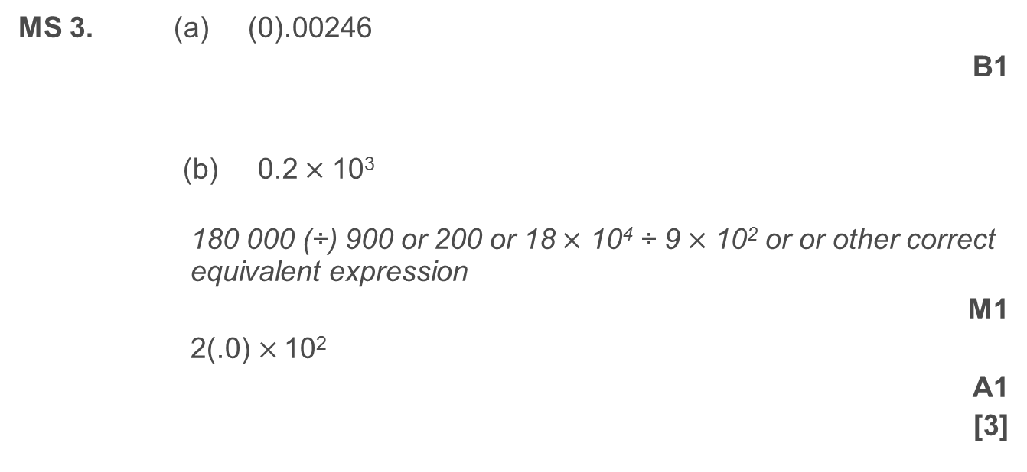
MS 3. (a) (0).00246
B1
(b) 0.2$×$ 10³
180 000 (÷) 900 or 200 or 18$×$ 10⁴ ÷ 9$×$ 10² or or other correct equivalent expression
M1
2(.0)$×$ 10²
A1
[3]
Copyright © AQA and its licensors. All rights reserved.

Slide 26
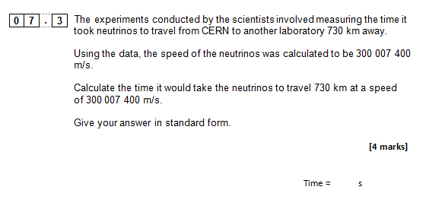
GCSE Physics sample assessment materials
Copyright © AQA and its licensors. All rights reserved.

Slide 27
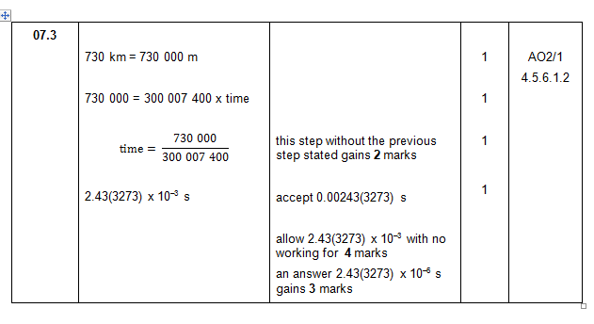
Copyright © AQA and its licensors. All rights reserved.

Slide 28
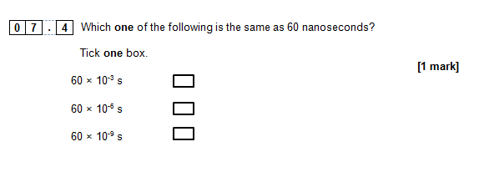

Copyright © AQA and its licensors. All rights reserved.

Slide 29
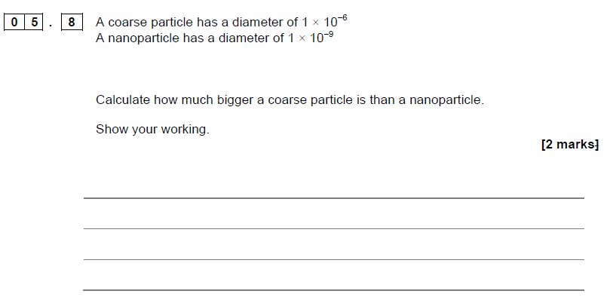
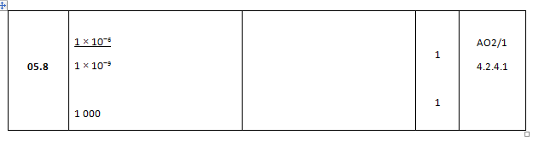
GCSE Chemistry sample assessment materials
Copyright © AQA and its licensors. All rights reserved.

