Slide 1
This Powerpoint outlines the mathematical requirements in the Science papers for algebra and includes the equations that need to be known for Physics, and those that will be given in the Physics papers.
It also gives the physical quantities that will need to be known and their units.
You should be wholly familiar with the contents ahead of taking your Science GCSEs.

Slide 2
Combined Science – Algebra
From the Combined Science Specification
Students will be required to demonstrate the following mathematics skills in GCSE Combined Science Assessments
a | Understand and use the symbols: =, <, <<, >>, α, ≈applying to everyday life.
b | Change the subject of an equation
c | Substitute numerical values into algebraic equations using appropriate units for physical quantities (chemistry and physics questions only)
d | Solve simple algebraic equations (biology and physics questions only)

Slide 3
Know these:
symbol | Words | Example Use
= | equals | 1 + 1 = 2
α | proportional to | current α voltage
≈ | approximately equal to | Mr Walker ≈ 95kg
> | greater than | 5 > 2
< | less than | 7 < 9
>> | much greater than | 3 x 10⁸ >> 330

Slide 4
Example: What is x+3, when we know that x is greater than 11?
If x > 11 , then adding three to both sides:
x+3 > 14
(Imagine that "x" is the number of people at your party. If there are more than 11 people at your party, and 3 more arrive, then there must be more than 14 people at your party now.)

Slide 5
Physics equations.
In solving quantitative problems, students should be able to recall and apply the following equations, using standard SI units.
1 | weight = mass x gravitational field strength (g) | W = mg
2 | work done = force x distance (along line of action of the force) | W = F s
3 | force applied to a spring = spring constant x extension | F = k e
4 | distance travelled = speed x time | s = v t
5 | acceleration = ^{change in velocity} / _{time taken} | a = Δv/t
6 | resultant force = mass x acceleration | F = m a
7 | HT momentum = mass x velocity | p = m v

Slide 6
Take time to practise using the first seven formulae by making up some questions.
W = mg
W = Fs
F = k e
s = v t
a = Δv/t
F = m a
p = m v
Now rearrange the equations to make each of the quantities on the right-hand side the subject of the equation.
e.g. W = mg can be re-arranged to give:
m = W/g and g = W/m
We can also write the triangle formula as:
W
m g

Slide 7
Physics equations.
In solving quantitative problems, students should be able to recall and apply the following equations, using standard SI units.
8 | kinetic energy = 0.5 x mass x (speed)² | E_{k} = ½ mv²
9 | grav. potential energy = mass x grav.field strength x height | E_{p} = mgh
10 | power = ^{energy transferred}/ _{time taken} | P = E/t
11 | power = ^{work done}/ _{time taken} | P = W/t
12 | efficiency = ^{useful output energy transfer}/ _{total input energy transfer} | η = ^{useful}/_{total}
13 | efficiency = ^{useful power output}/ _{total power input} | η = ^{useful}/_{total}
14 | wave speed = frequency x wavelength | v = f λ

Slide 8
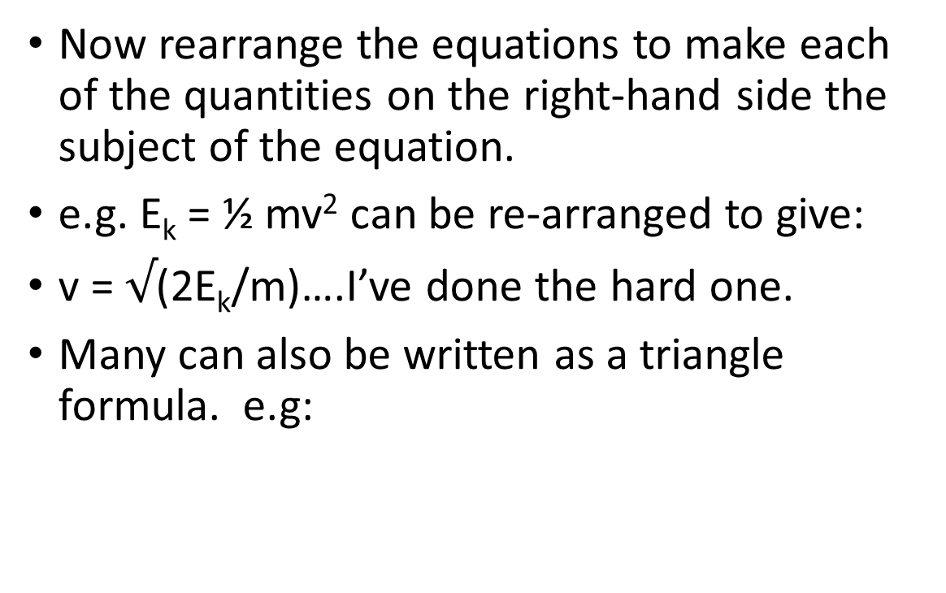
Take time to practise using the second seven formulae by making up some questions.
E_{k} = ½ mv²
E_{p} = mgh
P = E/t
P = W/t
η = ^{useful}/_{total}
η = ^{useful}/_{total}
v = f λ
Now rearrange the equations to make each of the quantities on the right-hand side the subject of the equation.
e.g. E_{k} = ½ mv² can be re-arranged to give:
v = $√$(2E_{k}/m)….I’ve done the hard one.
Many can also be written as a triangle formula. e.g:
v
f λ

Slide 9
Physics equations.
In solving quantitative problems, students should be able to recall and apply the following equations, using standard SI units.
15 | charge flow = current x time | Q = It
16 | potential difference = current x resistance | V = IR
17 | power = current x potential difference | P = IV
18 | power = (current)² x resistance | P = I²R
19 | energy transferred = power x time | E = Pt
20 | energy transferred = charge flow x potential difference | E = QV
21 | density = ^{mass}/ _{volume} | ρ = m/V

Slide 10
Physics equations.
In solving quantitative problems, students should be able to recall and apply the following equations, using standard SI units.
Just two additional formulae required for the separate Physics paper
22 | Moment of a force = force x distance (normal to direction of force) | M = Fd
23 | Pressure = force normal to a surface/area of that surface | P = F/A

Slide 11
Physics equations.
Students should be able to select and apply the following equations from the Physics equation sheet. Equations required for the higher tier papers only indicated by HT.
1 | (final velocity)² – (initial velocity)² = 2 x acceleration x distance | v²-u² = 2as
2 | elastic potential energy = 0.5 x spring constant x (extension)² | E_{e} = ½ k e²
3 | change in thermal energy = mass x specific heat capacity x temperature change | ΔE = mcΔθ
4 | period = ¹/_{frequency} | T = 1/f
5 HT | Force on a conductor (at right angles to the magnetic field) carrying a current = magnetic flux density a current x length | F = BIL
6 | Thermal energy for a change of state = mass x specific latent heat | E = mL
7 HT | potential difference across primary coil x current in primary coil = potential difference across secondary coil x current in secondary coil i.e power in = power out | V_{s}I_{s} = V_{p}I_{p}

Slide 12
Physical quantities and their units
Students should be able to use appropriate units for the physical quantities
Physical quantity |  | Unit
name | symbol | name | symbol
acceleration | a | metres per second squared | m/s²
charge | Q | coulomb | C
current | I | ampere | A
distance | s | metre | m
energy | E | joule | J
force | F | newton | N
frequency | f | hertz | Hz
mass | m | kilogram | kg
momentum | p | kilogram metres per second | kgm/s

Slide 13
Physical quantities and their units
Students should be able to use appropriate units for these physical quantities
Physical quantity |  | Unit
name | symbol | name | symbol
power | P | watt | W
pressure | P | pascal | Pa
resistance | R | ohm | Ω
speed, velocity | v | metre per second | m/s
temperature | T | degree Celsius | ºC
time | t | second | s
voltage | V | volt | V
wavelength | λ | metre | m
work | W | joule | J

Slide 14
Final points to note:
Do:
state, substitute, calculate,
add units & boldly underline.
Do pay careful attention to:
prefixes
powers of ten.
Prefix | power
femto | x 10⁻¹⁵
pico | x 10⁻¹²
angstrom | x 10⁻¹⁰
nano | x 10⁻⁹
micro | x 10⁻⁶
milli | x 10⁻³
kilo | x 10³
mega | x 10⁶
giga | x 10⁹
tera | x 10¹²

