Slide 1
P1 Conservation and dissipation of energy
1. An electric fan heater contains an electric heater and a fan driven by an electric motor.
1a) Describe the energy transfers that take place in the fan heater when it is operating normally.
1b) With reference to the fan heater, explain what is meant by
i) useful energy
ii) wasted energy
2. A bungee jumper jumps, from a platform and transforms 12000J from his gravitational potential energy store before the rope attached to him becomes taut and starts to stretch.
He then transfers a further 24000J from his gravitational potential energy store before he stops falling and begins to rise.
2a) Describe the energy transfers and changes to the jumper’s energy stores:
i) after he jumps, before the rope starts to stretch
ii) Calculate the maximum value of his kinetic energy store during his descent.

Slide 2
P1 Conservation and dissipation of energy
1. An electric fan heater contains an electric heater and a fan driven by an electric motor.
a) Operating normally:
(heater) electricity => heat,
(fan) electricity => kinetic energy & sound
b) i) For the fan heater, the useful energy is the heat and the movement (of the air).
ii) The wasted energy is the noise.

Slide 3
2. A bungee jumper jumps, from a platform and transforms 12000J from his gravitational potential energy store before the rope attached to him becomes taut and starts to stretch. He then transfers a further 24000J from his gravitational potential energy store before he stops falling and begins to rise
12000J of PE lost before rope even starts to stretch and store elastic energy
Further 24000J
of PE lost, but transferred into
Elastic energy.
2ai) GPE lost as KE gained as jumper descends.
2aii) GPE continues to be lost as jumper descends, KE lost as (s)he slows, Elastic PE gained as bungee stretches, until no KE left, as stationary at bottom of flight.
2b) Maximum KE = 12000J, as once elastic is taut, the jumper starts to slow down as KE converted to elastic potential energy.

Slide 4
P1 Conservation and dissipation of energy
3. A train on a straight level track is pulled at a constant speed of 23m/s by an engine with an output power of 700kW.
3ai) Calculate how much energy is transferred from the train to the surroundings in 300s.
ii) Calculate how far the train travels in 300s.
iii) Show that the resistive force of the engine is approximately equal to 30 000N.
iv) Explain why the driving force of the engine is equal and opposite to the resistive force of the train.
3b) The train moves onto an inclined section of the railway line where the track rises by 1m for every kilometre of track. Explain why the output power of the engine needs to be increased to maintain the same speed of 23 m/s.

Slide 5
P1 Conservation and dissipation of energy
3. A train on a straight level track is pulled at a constant speed of 23m/s by an engine with an output power of 700kW.
3ai) Calculate how much energy is transferred from the train to the surroundings in 300s.
Energy = power x time
E = 700 000 x 300 = 210 000 000J, or 210MJ
ii) Calculate how far the train travels in 300s.
Distance = speed x time
s = v x t, s = 23m/s x 300s = 6900m
iii) Show that the resistive force of the engine is approximately equal to 30 000N.
Work done = F x d
Since at a constant speed, no net force must be acting forwards, so all the 700kW must be overcoming friction.
So 210MJ = resistive force x 6900m
Rearranging: resistive force = 210 000 000/6900
Resistive force = 30 434N, so approx. equal to 30 000N

Slide 6
P1 Conservation and dissipation of energy
3a iv) Explain why the driving force of the engine is equal and opposite to the resistive force of the train.
iv)As the train is travelling at a constant speed, according to Newton’s first law of motion, there can be no net force acting. To balance out the resistive force, and give no net force, the driving force must be equal and opposite to the resistive force acting against the train.
3b) The train moves onto an inclined section of the railway line where the track rises by 1m for every kilometre of track. Explain why the output power of the engine needs to be increased to maintain the same speed of 23 m/s.
The train will now be gaining gravitational potential energy as well as working to overcome friction. The addition GPE must be provided from the power supplied to the engine. If the train is not to slow down, the additional energy gain must be provided by an increase of output energy from the engine.

Slide 7
P1 Conservation and dissipation of energy. Summary questions.
4 A student pushes a trolley of weight 150N up a slope of length 20m. The slope is 1.2m high.
a) Calculate the increase in the gravitational potential energy store of the trolley.
b) The student pushed the trolley up the slope with a force of 11N. Show that the work done by the student was 220J.
c) If the student pushed the trolley up the slope at constant speed, explain why all the work done by the student was not transferred to the gravitational potential energy store of the trolley

Slide 8
P1 Conservation and dissipation of energy. Summary questions.
4 A student pushes a trolley of weight 150N up a slope of length 20m. The slope is 1.2m high.
a) Calculate the increase in the gravitational potential energy store of the trolley.
b) The student pushed the trolley up the slope with a force of 11N. Show that the work done by the student was 220J.
c) If the student pushed the trolley up the slope at constant speed, explain why all the work done by the student was not transferred to the gravitational potential energy store of the trolley
a) Potential energy gain = mgΔh
Where Δh is the gain in height.
PE = 150 x 1.2 = 180J
b) Work done = Force x distance moved in direction of the force
W = F x d
W = 11 x 20 = 220J
c) The student did 220J of work to gain 180J of potential energy. 40J of energy must have been wasted as work done overcoming friction or as noise.

Slide 9
P1 Conservation and dissipation of energy. Summary questions.
5a A stone is fired into the air from a catapult and falls to the ground some distance away. Describe the energy transfers that take place after the catapult is released.
Youtube clip: very powerful catapult weapons https://www.youtube.com/watch?v=Bm5YOYrRejY
5b A stone of mass 0.015kg is catapulted into the air at a speed of 25 m/s. It reaches a height of 20m before it descends and hits the ground some distance away.
i) Calculate its initial kinetic energy.
ii) Calculate the increase in the gravitational potential energy store of the stone when it reached its maximum height (g = 9.81 N/kg)
iii) Estimate its speed when it was at its maximum height.

Slide 10
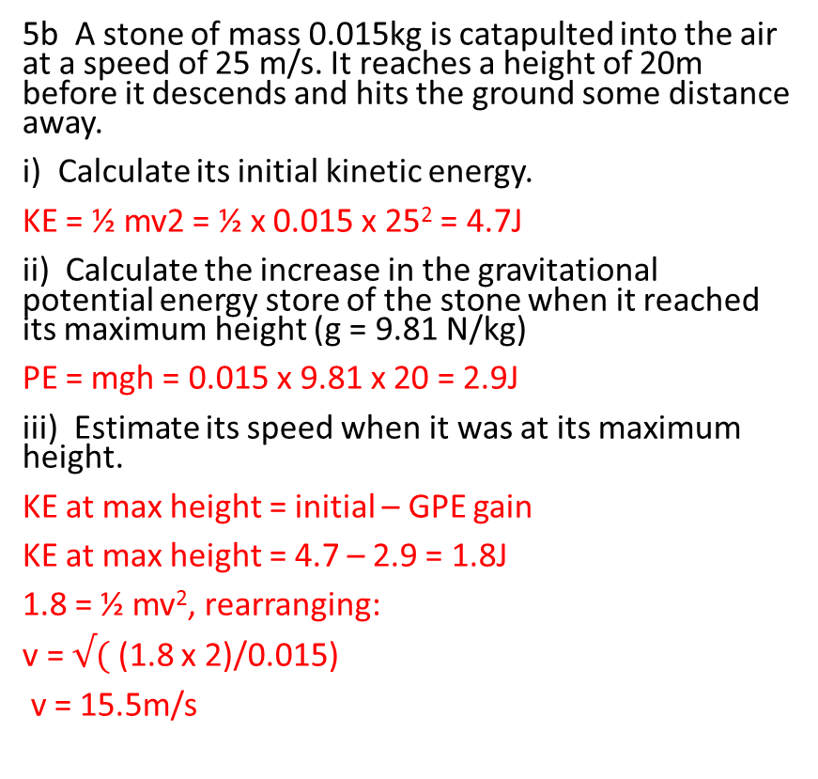
P1 Conservation and dissipation of energy. Summary questions.
5a A stone is fired into the air from a catapult and falls to the ground some distance away. Describe the energy transfers that take place after the catapult is released.
Elastic potential energy => KE of the elastic band and the stone.
Some KE of stone => GPE as it gains vertical height, losing some energy as heat due to wind resistance.
GPE => KE as stone passes through maximum height and falls back to the ground.
5b A stone of mass 0.015kg is catapulted into the air at a speed of 25 m/s. It reaches a height of 20m before it descends and hits the ground some distance away.
i) Calculate its initial kinetic energy.
KE = ½ mv2 = ½ x 0.015 x 25² = 4.7J
ii) Calculate the increase in the gravitational potential energy store of the stone when it reached its maximum height (g = 9.81 N/kg)
PE = mgh = 0.015 x 9.81 x 20 = 2.9J
iii) Estimate its speed when it was at its maximum height.
KE at max height = initial – GPE gain
KE at max height = 4.7 – 2.9 = 1.8J
1.8 = ½ mv², rearranging:
v = $√($ (1.8 x 2)/0.015)
v = 15.5m/s

Slide 11
P1 Conservation and dissipation of energy. Summary questions.
6 A parachutist of total mass 75kg jumps from an aeroplane moving at a speed of 60m/s at a height of 900m above the ground.
a) Calculate her kinetic energy when she left the aeroplane.
b) Her parachute reduce her speed of descent to 5m/s.
i) Calculate her kinetic energy at this speed.
ii Calculate the decrease in her gravitational potential energy store as a result of her descent.
c) Calculate the work done by air resistance during her descent.

Slide 12
P1 Conservation and dissipation of energy. Summary questions.
6 A parachutist of total mass 75kg jumps from an aeroplane moving at a speed of 60m/s at a height of 900m above the ground.
a) Calculate her kinetic energy when she left the aeroplane.
b) Her parachute reduced her speed of descent to 5m/s.
i) Calculate her kinetic energy at this speed.
ii Calculate the decrease in her gravitational potential energy store as a result of her descent.
c Calculate the work done by air resistance during her descent.
a) KE = ½ mv², horizontal KE
KE = ½ x 75 x 60² = 135 000J
bi) KE = ½ mv², vertical KE
KE = ½ x 75 x 5² = 938J
bii) When she was at 900m,
GPE = mgh,
= 75kg x 10N/kg x 900m = 675 000J
And zero once she reached the ground.
c) Work done by air resistance covered her loss of her initial KE, loss of her initial GPE => leaving only her final KE at landing.
135000J + 675000J – 938J = 809062J.

Slide 13
P1 Conservation and dissipation of energy. Summary questions.
7 On a building site, a 600W electric winch and a pulley were used to lift bricks from the ground. The winch raised a load of 500N through a vertical height of 3.0m in 25s. During this time, the average power supplied to the winch was 600W.
ai) Calculate how much useful energy was transferred by the motor.
ii) Calculate the percentage efficiency of the system.
b) Explain why the efficiency of a winch can never be as much as 100%.
ai) GPE = mgh
GPE = 500 x 3.0 = 1500J
aii) efficiency = useful gained/total
η = 1500/(600 x 25)
η = 0.1, or 10%
b) All winches will have some friction between the moving wheel and the fixings of the axle to the frame. Consequently some energy will be wasted overcoming friction and lost as heat to the atmosphere.

