Slide 1
P3 Energy Resources, P3.1 Energy demands
Key points
The UK energy demands are met mostly by burning oil, coal and gas.
Nuclear power, biofuels, and renewable resources provide energy to generate some of the electricity we use.
Uranium or plutonium are used as the fuel in a nuclear power station. Much more energy is released per kilogram than from fossil fuels.
Biofuels such as methane and ethanol are renewable sources of energy as they are derived from a living organisms, used at the same rate as they are replaced.
A biofuel is carbon neutral because the carbon given out was only recently taken in.
Videos to support the learning of this topic:
Energy Sources of the Future: 13 min
https://www.youtube.com/watch?v=uStFvcz9Or4
https://www.youtube.com/watch?v=1kUE0BZtTRc 4 minutes Renewable Energy

Slide 2
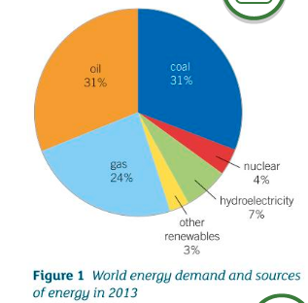
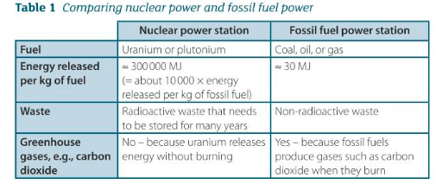
P3 Energy Resources, P3.1 Energy demands
Additional notes: Record Figure 1:
Reproduce Table 1: Comparing nuclear power and fossil fuel power

Slide 3
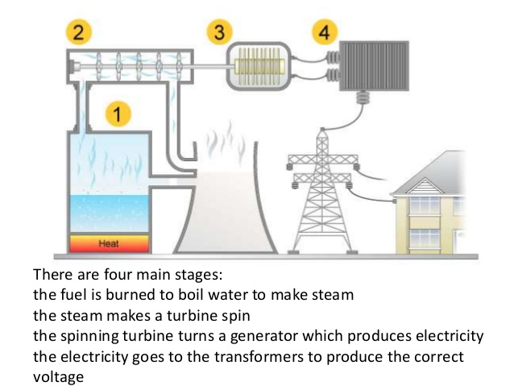
P3.1 Energy demands
Additional notes: Inside a thermal power station:

Slide 4
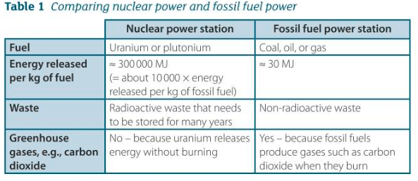
P3.1 Energy demands
1ai) Name the types of power stations that release carbon dioxide into the atmosphere.
aii) Name the type of power station that does not release carbon dioxide into the atmosphere.
b) Nuclear fuel releases about 10000 times as much energy as the same mass of fossil fuel. Give one disadvantage of nuclear fuel compared with other types of fuel.
2a) Give one advantage and one disadvantage:
i) an oil-fired power station compared with a nuclear power station
ii) a gas-fired power station compared with a coal-fired power station.
b) Look at Table 1.
Calculate how many kilograms of fossil fuel would give the same amount of energy as 1 kilogram of uranium fuel.
3a) Explain why ethanol is described as biofuel.
b) Ethanol is also described as carbon-neutral. Explain what a carbon-neutral fuel is.
4 Global energy usage is currently about 5.0 x 10²⁰ joules per year. The global population is about 6 x 10⁹ people. Estimate how much energy per second each person uses on average.

Slide 5
P3.1 Energy demands (answers)
Oil fired: advantage: no risk of leak of radioactive waste.
Disadvantage: Polluting carbon dioxide, a greenhouse gas, and sulphur dioxide given off when burned.
ii) a gas-fired power station compared with a coal-fired power station.
Advantage: starts quicker & less pollution given off for the same amount of energy.
Disadvantage: UK has less of its own gas compared to coal reserves.
b) Look at Table 1. Calculate how many kilograms of fossil fuel would give the same amount of energy as 1 kilogram of uranium fuel.
1kg of uranium: 300 000 MJ
1kg of fossil fuel 30MJ, so need 10,000kg of fossil fuel to give the same energy outpu
1ai) Name the types of power stations that release carbon dioxide into the atmosphere.
coal, gas, oil
aii) Name the type of power station that does not release carbon dioxide into the atmosphere.
nuclear, hydroelectricity, wind
b) Nuclear fuel releases about 10,000 times as much energy as the same mass of fossil fuel. Give one disadvantage of nuclear fuel compared with other types of fuel.
It produces radioactive waste which has to be managed.
2a) Give one advantage and one disadvantage:
i) an oil-fired power station compared with a nuclear power station.

Slide 6
P3.1 Energy demands (answers)
3a) Explain why ethanol is described as biofuel.
A biofuel is any fuel obtained from living or recent organisms, and ethanol is formed from fermented sugar cane, a plant.
b) Ethanol is also described as carbon-neutral. Explain what a carbon-neutral fuel is.
The carbon that the living organism takes in from the atmosphere as carbon dioxide balances the amount released when its burnt.
4 Global energy usage is currently about 5.0 x 10²⁰ joules per year. The global population is about 6 x 10⁹ people. Estimate how much energy per second each person uses on average.
(5.0 x 10²⁰)/(365.25 x 24 x 60 x 60) = global use per s, 1.58 x 10¹³J/s
1.58 x 10¹³J/s /(6 x 10⁹) = 2640W
2.6kW, or 2600 J/s per person on Earth.

Slide 7
P3.1 Energy demands (answers)
The Energy Resources posters are an ideal way of conveying the information.
https://highdown.sharepoint.com/:p:/r/sites/sciencedept/_layouts/15/Doc.aspx?sourcedoc=%7B1d4285cd-a43f-43ff-a3f6-ad127b3ee6a1%7D&action=edit&uid=%7B1D4285CD-A43F-43FF-A3F6-AD127B3EE6A1%7D&ListItemId=14961&ListId=%7BE2634438-FD60-48EB-9266-EDE0FE0A13E1%7D&odsp=1&env=prod

