Slide 1
P3.2 Energy from wind and water
Key points
A wind turbine is an electricity generator on top of a tall tower.
Waves generate electricity by turning a floating generator.
Hydroelectricity generators are turned by water running downhill.
A tidal power station traps each high tide and uses it to turn generators.
Videos to support the lesson:
Dinorwig,4:12 Dinorwig – The Oneshow https://www.youtube.com/watch?v=SWiURkNnBoU
Dinorwig, 11:00 The Electric Mountain Fully Charged
https://www.youtube.com/watch?v=McByJeX2evM

Slide 2
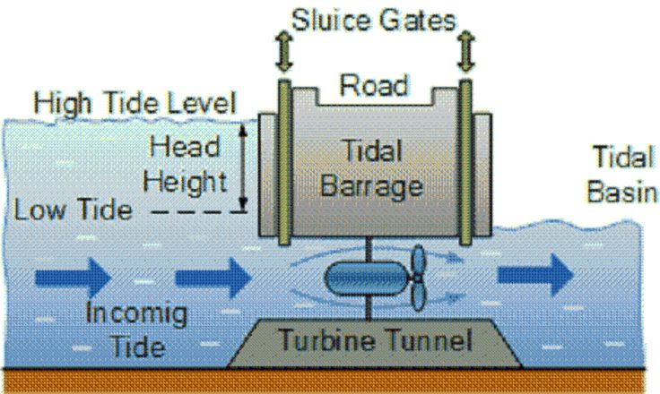
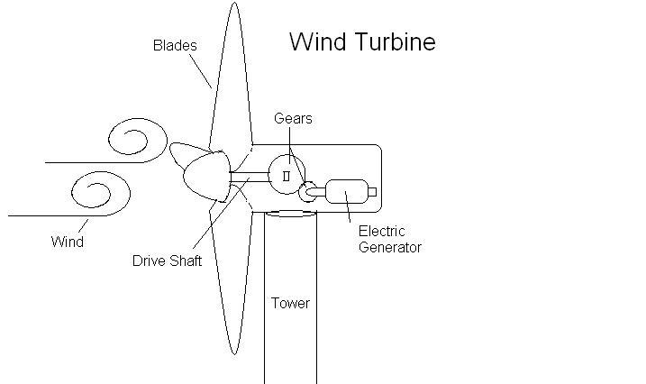
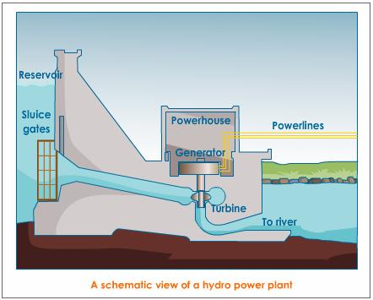
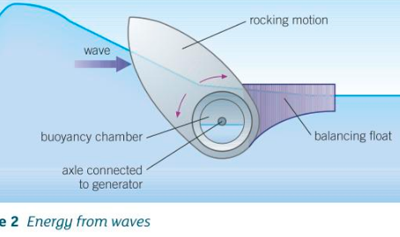
P3.2 Energy from wind and water
Additional notes:
A tidal power station traps water from each high tide behind a barrage. The high tide can then be released into the sea through turbines once the tide has dropped beyond the barrage.

Slide 3
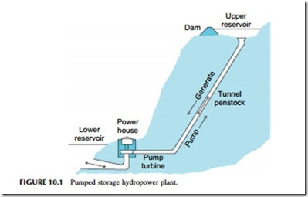
P3.2 Energy from wind and water
Pumped storage:
Uses cheap off-peak electricity to pump water to a high level reservoir. Released next day to produce high value electricity to cover peak in demand.

Slide 4
P3.2 Energy from wind and water
1 Hydroelectricity, tidal power, wave power, and wind power are all renewable energy sources.
a) Explain what a renewable energy resource is.
b) Name the renewable energy resource listed above that:
i) does not need energy from the Sun
ii) does not need water and is unreliable.
2a) Use the table for this question. The output of each source is given in millions of watts (MW).
i) Calculate how many wind turbines would give the same total power output as a tidal power station.
ii) Calculate how many kilometres of wave generators would give the same output as a hydroelectric power station.
b) Use the words below to complete the location column in the table:
Coastline, estuaries, hilly or coastal areas, mountain areas
Power Station | Output MW | Location | Total cost in £ per MW
Hydro | 500/station |  | 50
Tidal | 2000/station |  | 300
Wave | 20/km |  | 100
Wind | 2/turbine |  | 90

Slide 5
P3.2 Energy from wind and water
1 Hydroelectricity, tidal power, wave power, and wind power are all renewable energy sources.
a) Explain what a renewable energy resource is. A renewable resource will never run out, as replenished by natural processes at the same rate as it is used.
b) Name the renewable energy resource listed above that:
i) does not need energy from the Sun. Tidal power (gravitational pull of the Moon->tides)
ii) does not need water and is unreliable. Wind power
2a) Use the table below for this question. The output of each source is given in millions of watts (MW).
i) Calculate how many wind turbines would give the same total power output as a tidal power station.
2000/2 = 1000 wind turbines for 1 tidal station
ii) Calculate how many kilometres of wave generators would give the same output as a hydroelectric power station.
500/20 = 25km of wave turbines = 1 HEP station
b) Use the words below to complete the location column in the table:
Coastline, estuaries, hilly or coastal areas, mountain areas
Power Station | Output MW | Location | Total cost in £ per MW
Hydro | 500/station | mountain | 50
Tidal | 2000/station | estuary | 300
Wave | 20/km | coastline | 100
Wind | 2/turbine | Hilly or coastline | 90

Slide 6
P3.2 Energy from wind and water
3 The last column in the table above shows an estimate of the total cost per MW for generating electricity using different renewable energy resources. The total cost of each resource includes its running costs and the capital costs to set it up.
a) The capital cost per MW of a tidal power station is much higher than that of a hydroelectric power station. Give one reason for this difference.
b)i) Name the energy resource that has the lowest total cost per MW.
ii) Give two reasons why this resource might be unsuitable in many locations.

Slide 7
P3.2 Energy from wind and water
3 The last column in the table above shows an estimate of the total cost per MW for generating electricity using different renewable energy resources. The total cost of each resource includes its running costs and the capital costs to set it up.
a) The capital cost per MW of a tidal power station is much higher than that of a hydroelectric power station. Give one reason for this difference.
Coastal sites, estuaries are likely to be developed so there will be an additional cost in buying the land. Foundations will be expensive, as there will be soft ground requiring piling – as rock could be a long way down.
Hydroelectric power stations will be built on areas of rock, and not generally heavily habituated – so not so expensive to acquire the site.
b)i) Name the energy resource that has the lowest total cost per MW.
HEP has the lowest cost in £ per MW.
ii) Give two reasons why this resource might be unsuitable in many locations.
HEP requires a regular rainfall, and a site for a high level reservoir that can be created behind a dam. Both are needed, and not may sites can offer both.

Slide 8
P3.2 Energy from wind and water
4a) Explain what a pumped storage scheme is.
b) Describe what the main benefit to electricity users of a pumped storage scheme.

Slide 9
P3.2 Energy from wind and water
4a) Explain what a pumped storage scheme is.
A pumped storage scheme has a high level reservoir that drains through turbines to a low level reservoir. The gravitational PE is turned into electricity. During the night, low cost (excess electricity) from nuclear power stations is used to pump the water back up to the high level reservoir, ready to provide electricity at peak times when the gates are opened to allow water to stream back down.
b) Describe what the main benefit to electricity users of a pumped storage scheme.
The scheme obviates the need for a fossil fuel power station to cover the peaks in demand, and helps use electricity that would otherwise pass unused.
Coal, oil and nuclear power stations run continuously. They cannot be re-started quickly if the demand rises suddenly.

