Slide 1
P3.3 Power from the Sun and Earth
Key points
Solar cells are flat solid cells and use the Sun’s energy to generate electricity directly.
Solar heating panels use the Sun’s energy to heat water directly.
Geothermal energy comes from the energy transferred by radioactive substances deep inside the Earth.
Water pumped into hot rocks underground produces steam to drive turbines at the Earth’s surface that generate electricity.
Videos to support learning:
https://www.youtube.com/watch?v=OPI-2B29btU geothermal 2.00min
https://www.youtube.com/watch?v=loJjcGutYZg 2:44min wind and solar

Slide 2
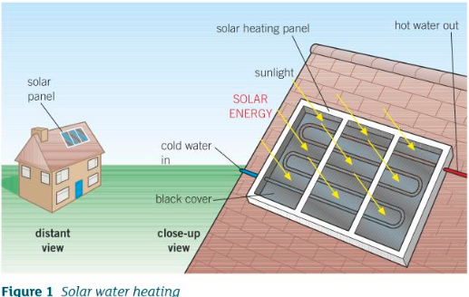
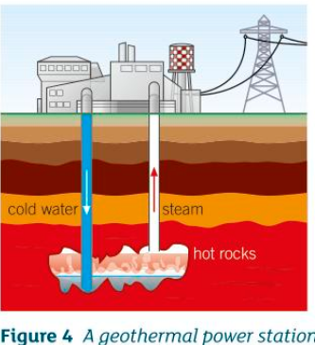
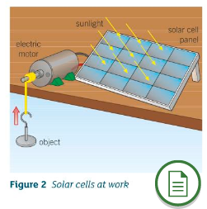
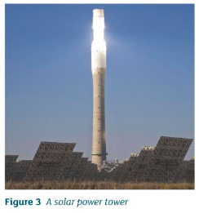
P3.3 Power from the Sun and Earth
Additional notes:
Draw Figure 1 – to recognise difference of solar water heating from solar cells of Figure 2
Draw figure 4 - Geothermal energy

Slide 3
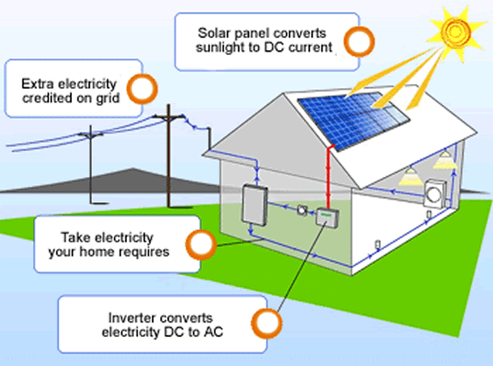
P3.3 Power from the Sun and Earth
Additional notes:
https://www.youtube.com/watch?v=xKxrkht7CpY
How solar cells work, 4:58 min
https://www.youtube.com/watch?v=XwFB22r9zRo
The latest on Solar Panel inventions (May 2020)

Slide 4
P3.3 Power from the Sun and the Earth
1a) What is the source of geothermal energy?
b) State why geothermal energy is more reliable than solar energy for heating water.
2 A satellite in space uses a solar cell panel for electricity. The panel generates 300W of electrical power and has an area of 10m².
a) Each cell generates 0.2W. Calculate how many cells are in the panel.
b) The satellite carries batteries that are charged by electricity from the solar panels. State why batteries are carried as well as solar cell panels.
3 A certain geothermal power station has a power output of 200 000W.
a) Calculate how many kilowatt-hours of energy the power station generates in 24 hours.
b) Give one advantage and one disadvantage of a geothermal power station compared with a wind turbine.

Slide 5
P3.3 Power from the Sun and the Earth
1a What is the source of geothermal energy? Energy transferred by radioactive substances deep inside the Earth.
b) State why geothermal energy is more reliable than solar energy for heating water.
The Sun does not shine in the night sky, the geothermal energy is always available.
2 A satellite in space uses a solar cell panel for electricity. The panel generates 300W of electrical power and has an area of 10m2.
a) Each cell generates 0.2W. Calculate how many cells are in the panel.
No. = 300W/0.2W = 1500 cells in the panel.
b) The satellite carries batteries that are charged by electricity from the solar panels. State why batteries are carried as well as solar cell panels.
When the satellite is in the Earth’s shadow it is powered by the batteries it carries, as solar energy is not directly available.
3 A certain geothermal power station has a power output of 200 000W.
a) Calculate how many kilowatt-hours of energy the power station generates in 24 hours.
E = P x t
E = 200kW x 24h = 4800kWh
b) Give one advantage and one disadvantage of a geothermal power station compared with a wind turbine.
One advantage is that geothermal energy is reliable, whereas you can get calm days. A disadvantage is that it requires hot rocks close to the surface, otherwise it is uneconomical.

Slide 6
P3.3 Power from the Sun and Earth
4 A solar water panel heats the water flowing through it from 14ºC to 35ºC when water flows through it at a rate of 0.010 kilograms per second.
a) Calculate the energy per second transferred by the hot water from the solar panel.
b) Estimate the output temperature of the hot water if the flow rate is reduced to 0.007kg/s. The specific heat capacity of water is 4200 J/kgºC.

Slide 7
P3.3 Power from the Sun and Earth
4 A solar water panel heats the water flowing through it from 14ºC to 35ºC when water flows through it at a rate of 0.010 kilograms per second.
a) Calculate the energy per second transferred by the hot water from the solar panel.
H = mcΔT per second
H is heat transferred in J
m is the mass in kg
C is the specific heat capacity
ΔT is the temperature change in ºC
H = 0.010 x 4200 x (35-14) = 882 J/s
b) Estimate the output temperature of the hot water if the flow rate is reduced to 0.007 kg/s. The specific heat capacity of water is 4200 J/kgºC.
H = mcΔT per second
Assume same amount of energy is passed to the water in 1 s:
H/mc = ΔT, re-arranging:
882/(0.007 x 4200) = 29ºC
Assume water started at 13ºC, output temperature is 29 + 13 = 42ºC.

