Slide 1
P3.5 Big energy issues
Key points
Gas-fired power stations and pumped-storage stations can meet variations in demand.
Nuclear power stations are expensive to build, run and decommission.
Carbon capture of fossil fuel emissions is likely to be very expensive.
Renewable resources are cheap to run, but expensive to install.
Nuclear power stations, fossil-fuel power stations that use carbon capture technology, and renewable energy resources are all likely to be needed for future energy supplies.
Front end of national power:
http://grid.iamkate.com/

Slide 2
P3.5 Big energy issues
Videos to support the lesson:
https://www.youtube.com/watch?v=SWiURkNnBoU One Show comes to Dinorwig Power Station 4:12
https://www.youtube.com/watch?v=wFIVfwTUQmw 15 minutes​ The UK Electricity Network Generation, Transmission, Distribution and Supply (Dry but good material)
https://www.youtube.com/watch?v=VTAFjhO1HNo 3 minutes - Supply and demand – short and sweet – good board notes​
Response to demand: TV pick-up https://www.youtube.com/watch?v=UTM2Ck6XWHg​
Fully charged:-​ https://www.youtube.com/watch?v=vX0G9F42puY
Catch-up
https://www.youtube.com/watch?v=ONp8dismI-Q​
Additional notes:
The variable demand for electricity is met by:
Using nuclear and coal-fired power stations to provide a constant amount of electricity (the base load demand)
Using gas-fired power stations and pumped storage schemes to meet the daily variations in demand and extra demand in winter.
Using renewable resources when demand is high and when conditions for renewable generation are favourable.
Using renewable energy resources when demand is low to store energy in pumped storage schemes.

Slide 3
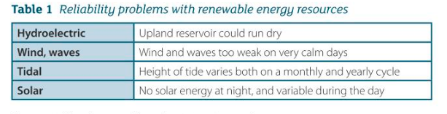
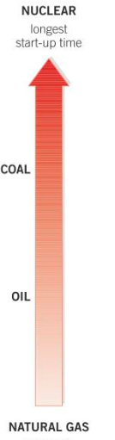
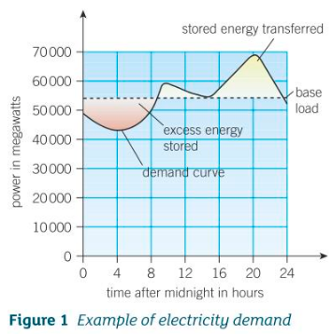
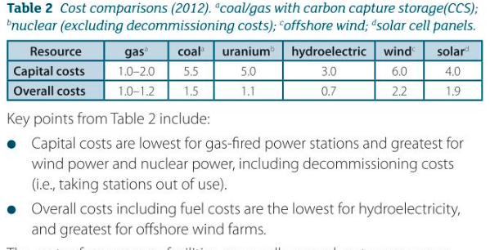
P3.5 Big energy issues
Additional notes:

Slide 4
P3.5 Big energy issues
1a) Name the type of power station that can be started fastest.
b) Name the type of power station that does not produce greenhouse gases or radioactive waste.
c) Name the types of renewable energy resource that are unreliable.
d) Name the type of renewable resource that can be used to store energy at times of low electricity demand.
2. People need to cut back on fossil fuels to reduce the production of greenhouse gases. What could happen if the only energy people used was:
a) renewable energy
b) nuclear power?
3 State why nuclear power stations are unsuitable for meeting daily variations in the demand for electricity.
4 State what pumped storage schemes are and why they are useful.
5 Using the data in Table 2, compare the use of fossil fuel resources with renewable resources.
a) Name the resource that has the lowest capital costs.
b) Hydroelectricity has the lowest overall costs. Give a reason why its overall cost is less than:
i) wind or solar power
ii) the non-renewable resources listed in Table 2.

Slide 5
P3.5 Big energy issues
c) The overall cost of a nuclear power station is about 9 pence per kWh. Nuclear reactor decommissioning costs have been estimated by the UK government at £1000 million per reactor. Estimate the extra overall cost per kWh of decommissioning a 4000MW reactor that has a lifetime of 30 years.
Resource | gas | coal | Uranium Excl. decom | hydroelectric | wind | solar
Capital costs | 1.0-2.0 | 5.5 | 5.0 | 3.0 | 6.0 | 4.0
Overall costs | 1.0-1.2 | 1.5 | 1.1 | 0.7 | 2.2 | 1.9

Slide 6
P3.5 Big energy issues (answers)
1a) Name the type of power station that can be started fastest. Natural gas
b) Name the type of power station that does not produce greenhouse gases or radioactive waste. Hydroelectric
c) Name the types of renewable energy resource that are unreliable. Solar, wind, wave, hydroelectric
d) Name the type of renewable resource that can be used to store energy at times of low electricity demand. Pumped storage
2. People need to cut back on fossil fuels to reduce the production of greenhouse gases. What could happen if the only energy people used was:
a) renewable energy – intermittent supply
b) nuclear power? – could run short of uranium ore, unable to cover peaks in demand economically.
3 State why nuclear power stations are unsuitable for meeting daily variations in the demand for electricity.
They have the longest start up time – so unable to respond to rapid variations in demand.
4 State what pumped storage schemes are and why they are useful.
You have a high level reservoir draining into a low level reservoir via some turbines driving a generator. At night, off-peak electricity from other sources is used to pump the water back to the top to be used at times of peak demand the next day.
5 Using the data in Table 2, compare the use of fossil fuel resources with renewable resources.
a) Name the resource that has the lowest capital costs.
A gas power station.
b) Hydroelectricity has the lowest overall costs. Give a reason why its overall cost is less than:
i) wind or solar power
An HEP power station can produce at lot of energy, so cost per unit is low once up and running. Solar and wind are relatively dilute forms of energy production.
ii) the non-renewable resources listed in Table 2.
Fuel needs to be paid for, and rain river run-off is free.

Slide 7
P3.5 Big energy issues
c) The overall cost of a nuclear power station is about 9 pence per kWh. Nuclear reactor decommissioning costs have been estimated by the UK government at £1000 million per reactor. Estimate the extra overall cost per kWh of decommissioning a 4000MW reactor that has a lifetime of 30 years.
(4000000kW x 30 x 365.25 x 24) = energy in kWh produced in 30 years
So £1000million/1.05x10¹²kWh = 0.1 pence per kWh => 9.1p/kWh.
Resource | gas | coal | Uranium Excl. decom | hydroelectric | wind | solar
Capital costs | 1.0-2.0 | 5.5 | 5.0 | 3.0 | 6.0 | 4.0
Overall costs | 1.0-1.2 | 1.5 | 1.1 | 0.7 | 2.2 | 1.9

