Slide 1
4 Electric circuits, 4.1a Circuit Symbols
Key points:
Every component has its own agreed symbol. A circuit diagram shows how the components are connected together.
A battery consists of two or more cells connected together.
Go to https://phet.colorado.edu/en/simulation/circuit-construction-kit-dc
and use the circuit lab simulation to gain experience in building circuits and handling the circuit symbols.

Slide 2
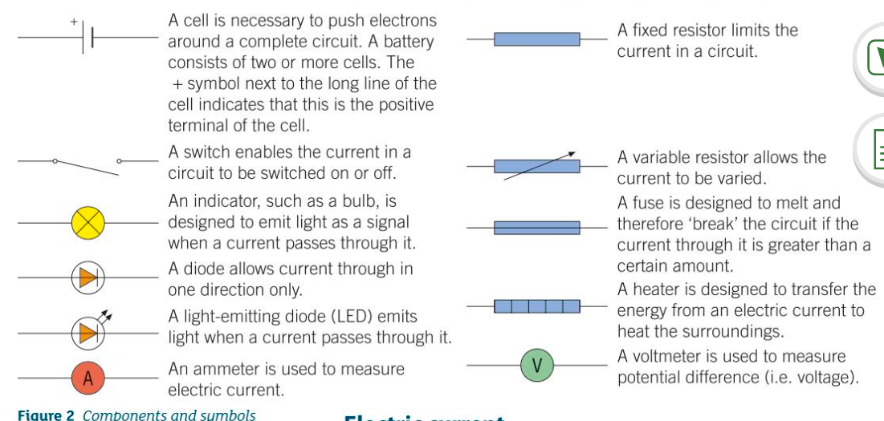
4 Electric circuits, 4.1a Circuit Symbols
p

Slide 3
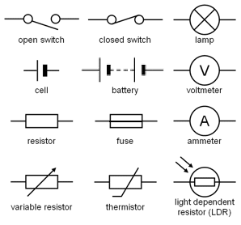
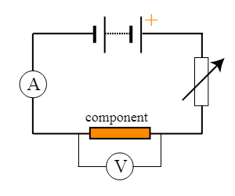
4.1a Circuit Symbols
Modify the voltmeter to form a bridge – as it bridges around a component.
The standard test circuit. The voltage-current characteristics for a component are measured using the standard test circuit.

Slide 4
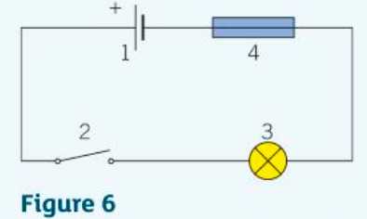
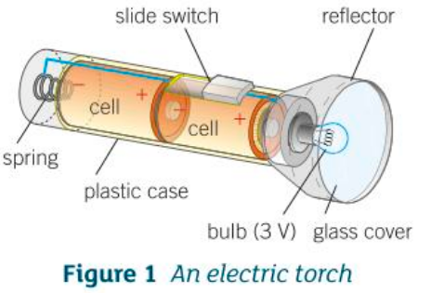
4.1a Circuit Symbols
1. Name the numbered components in the circuit diagram in Figure 6.
2a) Redraw the circuit diagram in Figure 6 with a diode in place of the switch so it allows current through.
p
b) Name the further component you would need in this circuit to change the current in it.
3a) State what an ammeter is used for.
b) State what a variable resistor is used for.
4a) Draw a circuit diagram for the electric torch in Figure 1.
p

Slide 5
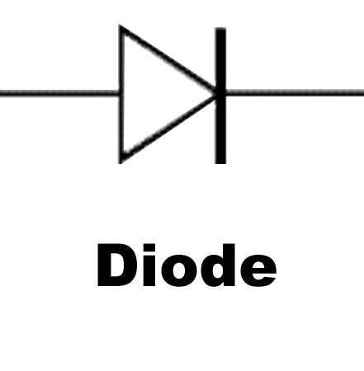
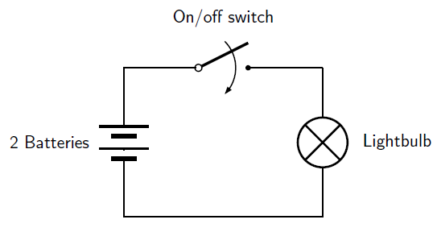
4.1a Circuit Symbols
1. Name the numbered components in the circuit diagram in Figure 6.
They are: 1 cell, 2 switch, 3 lamp, 4 fuse.
2a) Redraw the circuit diagram in Figure 6 with a diode in place of the switch so it allows current through.
Has to be from +ve to –ve for convention current.
b) Name the further component you would need in this circuit to change the current in it.
To change the current in the circuit you would need a variable resistor.
3a) State what an ammeter is used for.
An ammeter, connected in series, measures the current in the cable.
b) State what a variable resistor is used for.
A variable resistor is used to vary the current flowing through the circuit.
4a) Draw a circuit diagram for the electric torch in Figure 1.

