Slide 1
4 Electric circuits, 4.1b Current and charge
Videos to support the lesson:
GCSE Physics - Charge, Current & Time www.youtube.com/watch?v=TIHW5hEoaAw 2:38
GCSE Science Revision Physics "Charge in Circuits"
https://www.youtube.com/watch?v=ts7WumFAaSg 2:35
Key points:
The size of an electric current is the rate of flow of charge.
The equation for the electric current of a circuit is I = Q/t
The above equation can be rearranged to find charge flow, or time: Q = It, or t = Q/I
Mr Walker remembers it by saying: Charge ‘it’ to my wife’s account, as she looks after the money.

Slide 2
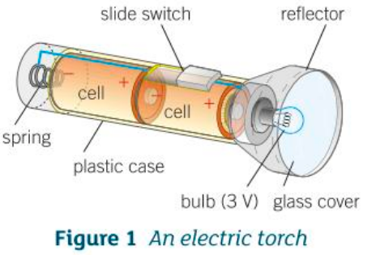
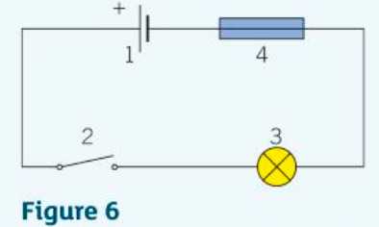
P4.1b Current and Charge
When the switch is closed in Figure 6, a current of 0.25A passes through the lamp. Calculate the charge that passes through the lamp in 60 seconds.
2) Describe the energy transfers of an electron around the torch circuit in Figure 1 when the switch is closed.

Slide 3
P4.1b Current and Charge
b) Describe the energy transfers of an electron around the circuit when the switch is closed.
When the switch is closed the electron flows round the circuit, from –ve to +ve. The electron passing through the battery gains energy from chemical reactions in the battery. It has kinetic energy which is transferred to heat energy as it works its way through the resistance of the filament. Collisions with the lattice of ions causes the KE to be turned to heat.
1. When the switch is closed in Figure 6, a current of 0.25A passes through the lamp. Calculate the charge that passes through the lamp in 60 seconds.
Q = It,
Q = 0.25 x 60 = 15C

